Slide 1


Slide 2
Merchant banking is a professional service provided by the merchant banks to their customers considering their financial needs, for adequate consideration in the form of fee. Merchant banks are banks that conduct fundraising, financial advising and loan services to large corporations.

Slide 3
A merchant bank is a financial institution that conducts underwriting, loan services, financial advising, and fundraising services for large corporations and high-net-worth individuals.
Merchant banks specialize in providing services for private corporations.
Unlike retail or commercial banks, merchant banks do not typically provide financial services to the general public.
Unlike investment banks, they focus on private companies not public companies. Examples of large merchant banks include JPMorgan Chase, Goldman Sachs, and Citigroup.

Slide 4


Slide 5
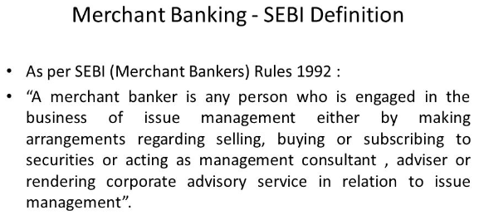

Slide 6
Functions of merchant banking
Corporate counselling
Issue management
Project counselling
Loan or credit Syndication
Portfolio management.
Raise capital
Leasing services

Slide 7

Objectives of merchant banking

Slide 8
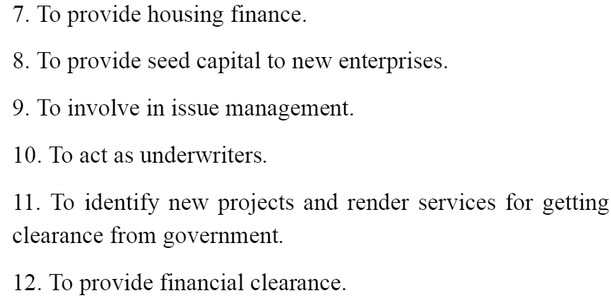

Slide 9
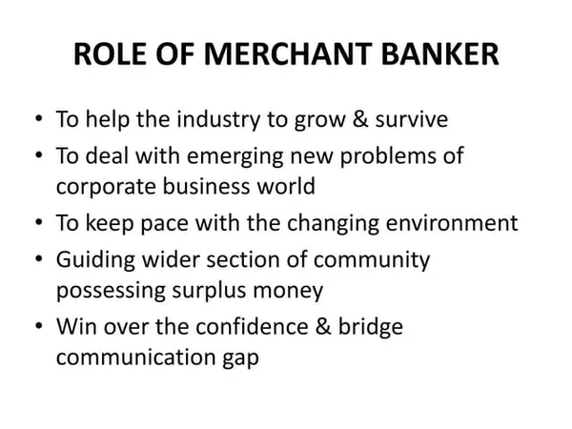

Slide 10
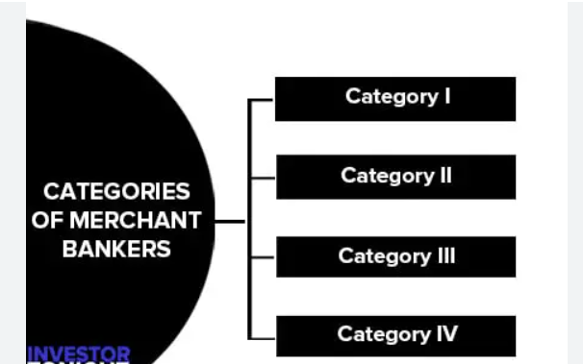

Slide 11
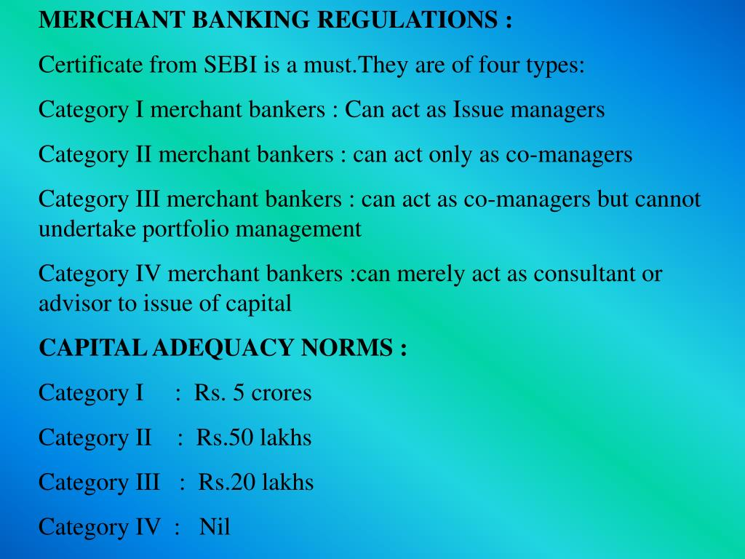

Slide 12
Role of SEBI in merchant banking
Registration
Grant of certificate
Capital adequacy
Restriction on business
Number of lead managers
Due diligence certificate
Submission of documents
Acquisition of shares
Disclosures
Code of conduct

