Slide 1
MIS

Slide 2
MANAGEMENT
INFORMATION
SYSTEM

Slide 3
Management
Management covers the planning, control, and administration of the operations of a concern. The top management handles planning; the middle management concentrates on controlling; and the lower management is concerned with actual administration.
Information
Information, in MIS, means the processed data that helps the management in planning, controlling and operations. Data means all the facts arising out of the operations of the concern. Data is processed i.e. recorded, summarized, compared and finally presented to the management in the form of MIS report.
System
Data is processed into information with the help of a system. A system is made up of inputs, processing, output and feedback or control.
Thus MIS means a system for processing data in order to give proper information to the management for performing its functions.

Slide 4
Management Information System or 'MIS' is a planned system of collecting, storing, and disseminating data in the form of information needed to carry out the functions of management.

Slide 5
OBJECTIVES OF MIS
The goals of an MIS are to implement the organizational structure and dynamics of the enterprise for the purpose of managing the organization in a better way and capturing the potential of the information system for competitive advantage
Following are the basic objectives of an MIS −
Capturing Data − Capturing contextual data, or operational information that will contribute in decision making from various internal and external sources of organization.
Processing Data − The captured data is processed into information needed for planning, organizing, coordinating, directing and controlling functionalities at strategic, tactical and operational level. Processing data means −
  making calculations with the data
  sorting data
  classifying data and
  summarizing data
.

Slide 6
Information Storage − Information or processed data need to be stored for future use.
Information Retrieval − The system should be able to retrieve this information from the storage as and when required by various users.
Information Propagation − Information or the finished product of the MIS should be circulated to its users periodically using the organizational network

Slide 7
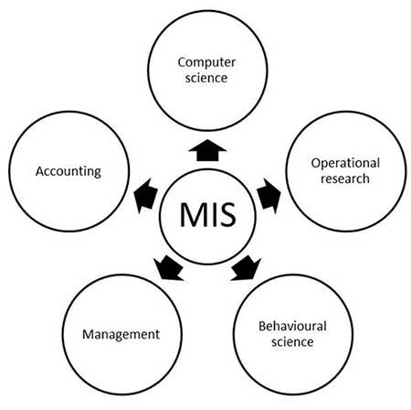
SCOPE AND NATURE OF MIS

Slide 8
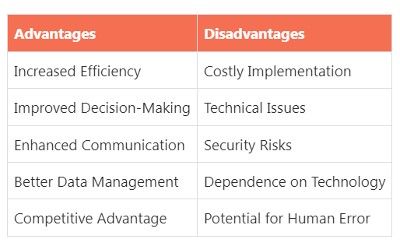

Slide 9
MIS REPORTS
MIS Reports are reports required by the management to assess the performance of the organization and allow for faster decision-making.
You can view the following types of MIS Reports in Tally.ERP 9:
● Accounting Reports: To obtain information on the financial position, operational performance and economic activities of the business.
● Financial Reports: To determine the financial condition of an organisation as required by shareholders, creditors and government units.
● Inventory Reports: To manage the Inventory effectively since the actual status of stock items is obtained.
● Management Control Reports: To utilise budgets, cost centre reports, scenario reports etc. for controlling activities.

Slide 10
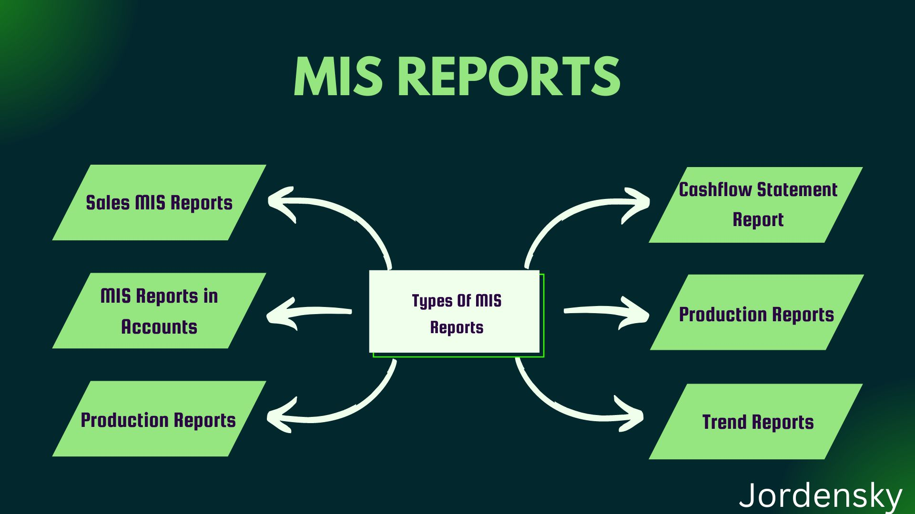

Slide 11
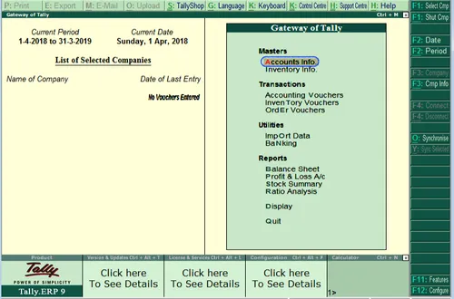

Slide 12
The two important parts of the financial statement are the Balance Sheet and the Profit & Loss account. Without the preparation of these two entities, the financial statement cannot be reported, and even the readers of the statement are not able to clearly understand the company’s position. Hence, due regard is to be given by every company in the preparation of the two. However, people don’t understand them very clearly and have problems distinguishing the two terms balance sheet vs p&l. Our law bookkeeping services will help you discriminate between both of them.
Balance Sheet
Meaning: A statement that shows the company's assets, liabilities, and equity at a specific date
Time frame: Financial condition on a certain date
Type: Statement
Information disclosed: Assets, liabilities, and capital of shareholders
The sequence of preparation: It is prepared after the preparation of the Profit & Loss Account

Slide 13
Profit & Loss Account
Meaning: Account that shows the company's revenue and expenses over a period of time
Time frame: Financial changes during the period
Type: Account
Information disclosed: Income, expenses, gains, and losses
The sequence of preparation: It is prepared before the preparation of the Balance Sheet

Slide 14
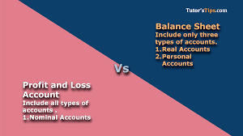

Slide 15
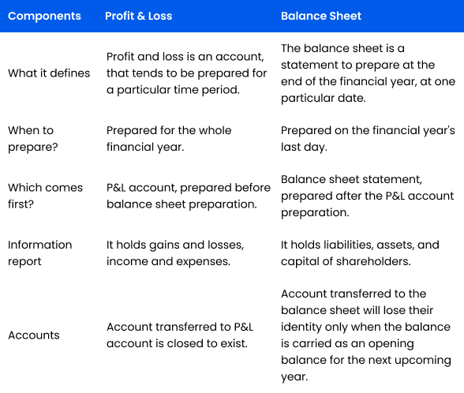

Slide 16
Purchase Register
A Purchase Register displays the information on the periodic purchases of a business concern. Purchase register helps in analyzing the details of movement of purchased goods to various godowns, on the basis of which the stock movement at each godown is determined. You can also view the columnar register for purchase. You can view this report in browser .
Purchase returns made during a year can also be traced. The parties to whom the purchase returns have been made and the causes thereof can be analysed to draw conclusions on the supplier and the quality of purchases made.
1. Go to Gateway of Tally > Display > Account books > Purchase Register . The Purchase Register appears as shown:

Slide 17
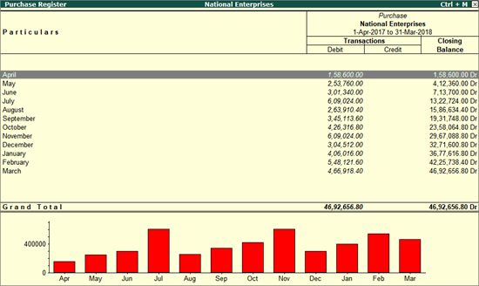

Slide 18
Sales REGISTER
Sales Register displays the monthly summary of sales transactions and closing balances. The list of transactions pertaining to each month can be viewed by selecting that month. You can change the display according to the information required.

Slide 19
Q.17 Enter the following transactions by creating relevant accounts and groups.
i) Purchased goods from Ram Rs.10000
ii) Purchased goods from Roshan Rs.5000
iii)Purchased goods from Mohan Rs.20000
iv)Sold goods to Leela Rs.25000
v) Sold goods to Praveena Rs.30000
vi)Sold goods to Praveen Rs.20000. Step1: Creation of a company
Path: GOT→ press Alt+f3 to activate company info → company Creation screen appears → enter the
relevant information.
Stept2: Creation of ledger
Path: GOT → Accounts Info → Ledger →Multiple Ledger → create Multiple ledger screen appears →
enter the details No Ledger Under group amount Dr/cr
1 purchases Purchases a/c
2 Sales Sales a/c
3 Ram S. creditors
4 Roshan S. creditors
5 Mohan S. creditors
6 Leela S. debtors
7 Praveena S. debtors
8 praveen S. debtors
Stept3: Creation of accounting vouchers
Path: GOT → Accounting Vouchers
S. No Particularss Vch No Lf Debit Credit
1 Purchases a/c _____________________ Dr
To Ram a/c
F7 10000
10000
2 Purchases a/c _____________________ Dr
To Roshan a/c
F7 5000
5000
3 Purchases a/c _____________________ Dr
To Mohan a/c
F7 20000
20000
4 Leela a/c _________________________ Dr
To sales a/c
F7 25000
25000
5 Praveena a/c _________________________ Dr
To sales a/c
F7 30000
30000
6 Praveen a/c _________________________ Dr
To sales a/c
F7 20000
20000
Step4: Display day book
Path: GOT → display → day book →Alt+F1

Slide 20
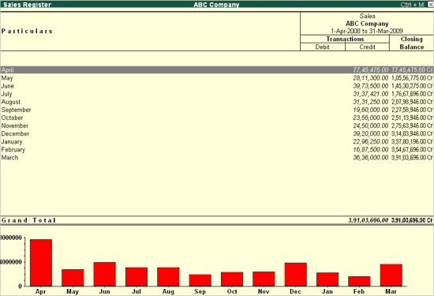
Go to Gateway of Tally > Display > Account books > Sales Register. The Sales Register screen is displayed as shown below:

Slide 21
Trial Balance
A trial balance is a summary of all ledger balances, and helps in checking whether the transactions are correct and balanced. If journal entries are error-free and posted correctly to the general ledger, the total of all debit balances should be equal the total of all credit balances. You can view this report in browser .
Note : By default, the Trial Balance report will be generated as on the date of the last voucher entry. You can change the date to view the report for the required period.

Slide 22
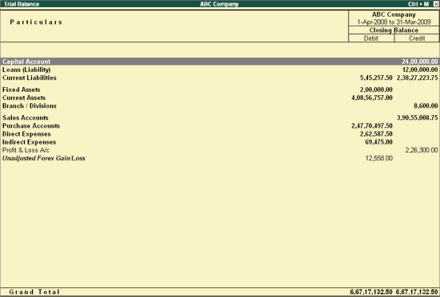
Go to Gateway of Tally > Display > Trial Balance . The Trial Balance appears as shown below:

Slide 23


Slide 24
Prepare a Trial Balance with the information given below: Furniture 10,000 Machinery 50,000. Building 1,00,000. Capital 1,50,000. Cash 5,000. Trade Debtors 80,000 Bills Payable 30,000. Trade Creditors 65,000.
STEP1: Creation of a company Path:GOT→press alt+f3 to activate company info create company →company Creation screen appears enter the relevant information Step2:Creation of ledger Path:GOT→alts info→ledger→multiple ledgercreate s.No Ledger name Under group Amount Dr/cr
1 Furniture Fixed asset 10000 Dr
2 Machinery Fixed asset 50000 Dr
3 Building Fixed asset 100000 Dr
4 Capital Capital 150000 Cr
5 Trade debtors s. debtors 80000 Dr
6 Bills payable Current liabilities 30000 Cr
7 Trade creditors Sundry creditor 65000 Cr
Step3:alter cash: GOT→ledger→multiple ledger-→alter→cash:5000
Step 4: display Trial balance: GOT→display→ trial balance→alt+f1

Slide 25
