Slide 1

MARKETING STRATERGY
AND
PLANNING

Slide 2
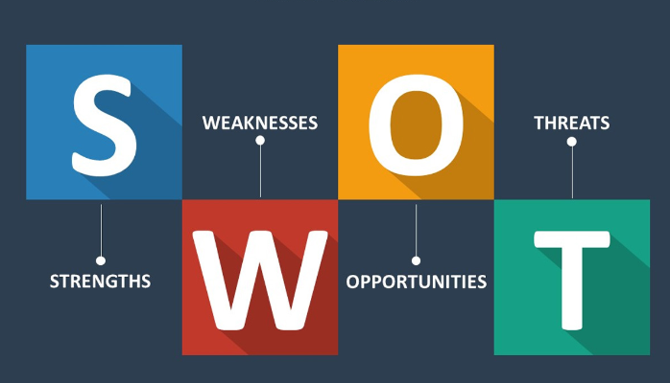
SWOT analysis is a strategic planning tool that helps organizations identify their internal strengths and weaknesses, as well as external opportunities and threats. The acronym "SWOT" stands for Strengths, Weaknesses, Opportunities, and Threats. It is a comprehensive framework that assists in understanding the current situation of a business or project. Here's an overview of each component:
Strengths:
  Internal attributes and resources that give an organization a competitive advantage.
  Examples include a strong brand reputation, skilled workforce, proprietary technology, efficient processes, or a loyal customer base.
Weaknesses:
  Internal factors that place the organization at a disadvantage or limit its competitive capabilities.
  Common weaknesses might include outdated technology, lack of skilled personnel, poor management, or inefficient internal processes.
.

Slide 3
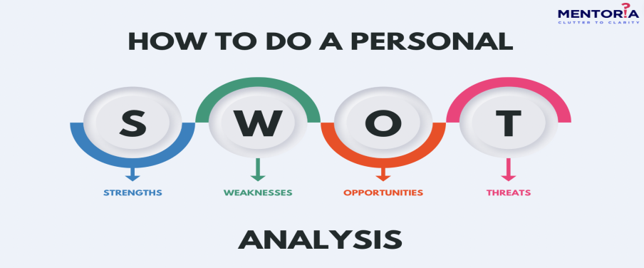
Opportunities:
  External factors or situations that the organization could exploit to its advantage.
  Opportunities may arise from market trends, technological advancements, changes in regulations, emerging customer needs, or gaps in the competition.
Threats:
  External factors that could negatively impact the organization and pose challenges to its success.
  Threats may come from competition, economic downturns, changes in consumer behavior, technological disruptions, or legal and regulatory issues

Slide 4
Corporate Strategy
Corporate strategy is a top-level plan designed to guide the actions and decisions of an entire organization. It involves setting long-term goals and determining the optimal approach for allocating resources across different business units and functional areas to achieve those goals. Corporate strategy is typically developed by top management and addresses questions related to the organization's overall scope, direction, and competitive advantage.

Slide 5

Mission and Vision:
  Defines the purpose and values of the organization (mission) and articulates the desired future state (vision).
Goal Setting:
  Establishes long-term objectives that the organization aims to achieve, providing a clear direction for the company.
Business Portfolio Management:
  Involves decisions about which business units or product lines the company should invest in, maintain, divest, or acquire.
Competitive Positioning:
  Determines how the organization will differentiate itself from competitors to gain a competitive advantage. This may involve cost leadership, differentiation, or focus strategies.

Slide 6
Diversification Strategies:
  Examines whether the organization should enter new markets or industries, either related or unrelated to its current business.
Mergers and Acquisitions (M&A):
  Considers whether growth and strategic objectives can be achieved through mergers, acquisitions, or strategic partnerships.
Resource Allocation:
  Allocates financial, human, and other resources to different business units or projects based on their strategic importance and potential for returns.
Risk Management:
  Identifies and assesses risks that may impact the organization's ability to achieve its strategic goals. Develops plans to mitigate these risks.
Strategic Implementation:
  Involves translating the strategic plan into specific actions, projects, and initiatives. Ensures alignment throughout the organization.
Performance Measurement:
  Establishes key performance indicators (KPIs) to monitor and evaluate the success of the corporate strategy. Regularly assesses performance against strategic goals.

Slide 7
Marketing planning is a systematic process that organizations use to outline marketing strategies and tactics to achieve specific business objectives. It involves setting goals, identifying target markets, developing marketing strategies, and implementing action plans. A well-structured marketing plan helps guide the marketing team, allocate resources effectively, and measure the success of marketing efforts.

Slide 8
