Slide 1
Organization of Data

Slide 2
Organization of data refers to the systematic arrangement of collected figures (raw data), so that the data becomes easy to understand and more convenient for further statistical treatment .
Raw data in the organisation of data is the unorganized information which is arranged to find out a comparison or conclusion.

Slide 3
Different stages of Organising Data
Editing the Data
Classification of Data
Tabulation of Data

Slide 4
Editing of Data
Editing the data refers to detect the possible errors and irregularities committed during the collection of data.
Purpose of Editing :According to W.B Bailey & John Cummungs
Editing for completeness
Editing for Uniformity
Editing for consistency
Editing for Accuracy

Slide 5
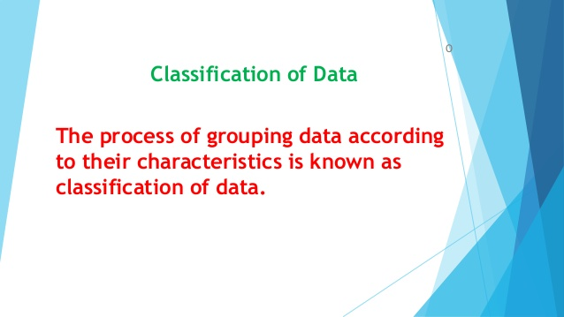

Slide 6
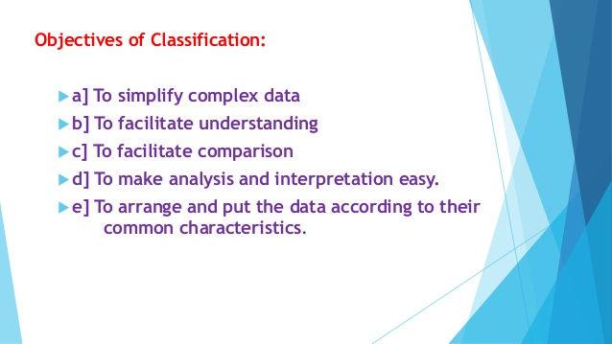

Slide 7
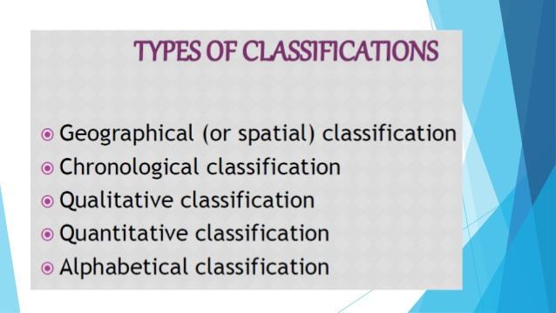

Slide 8
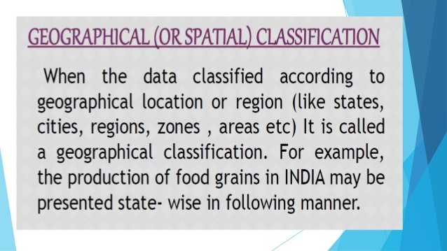

Slide 9
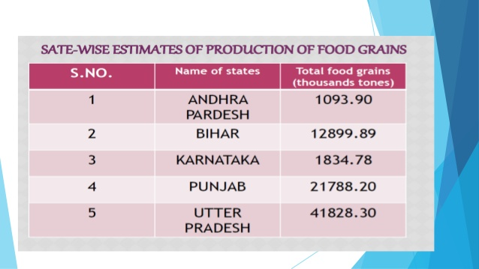

Slide 10
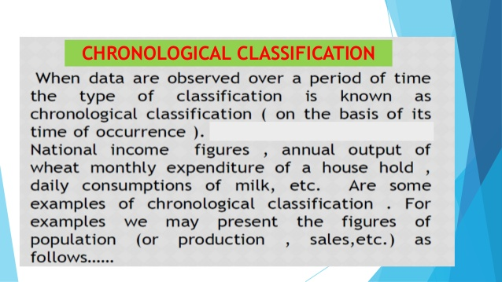

Slide 11
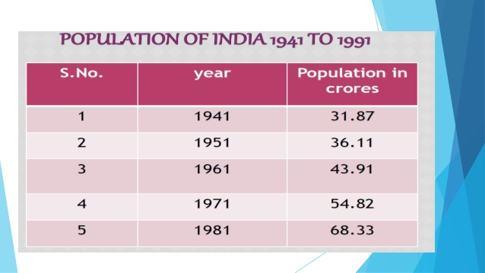

Slide 12
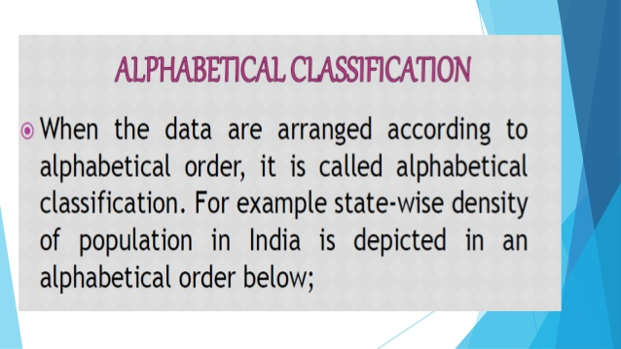

Slide 13
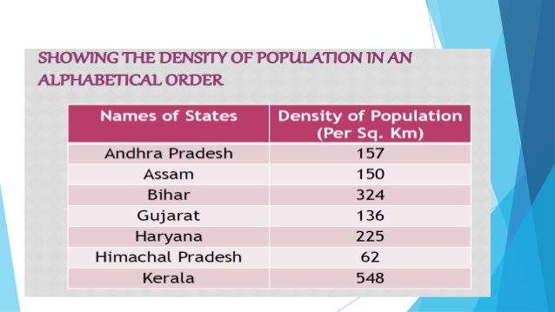

Slide 14
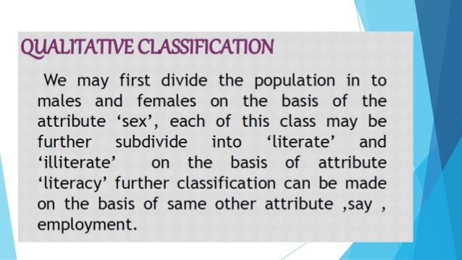

Slide 15
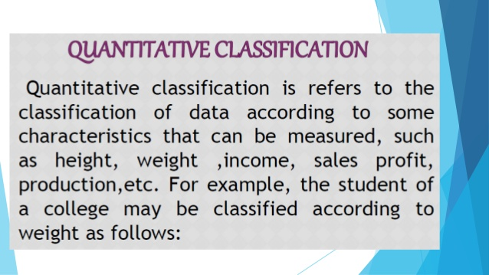

Slide 16
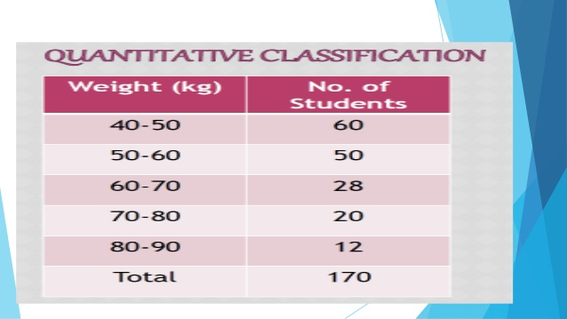

Slide 17
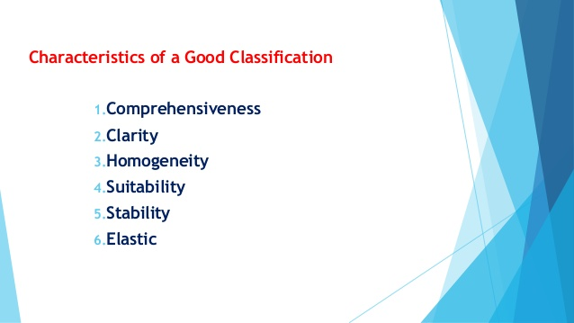

Slide 18
Process of classification
Raw Data
Individual Series
Frequency Distribution

Slide 19
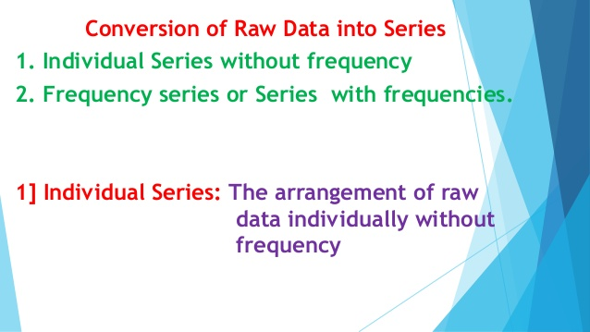

Slide 20
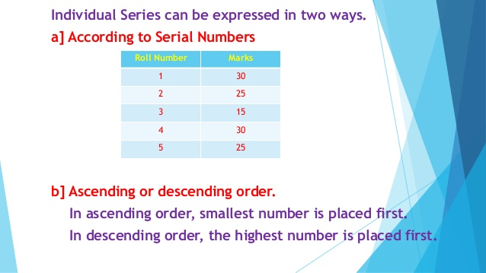

Slide 21
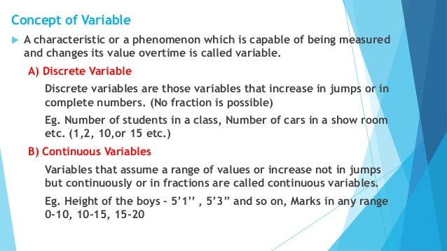

Slide 22
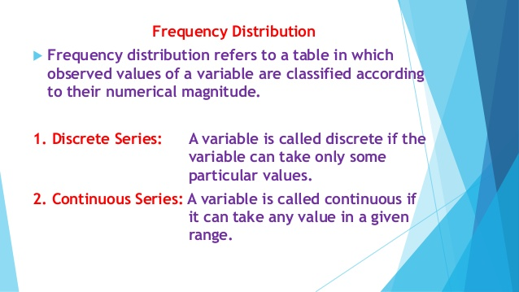

Slide 23
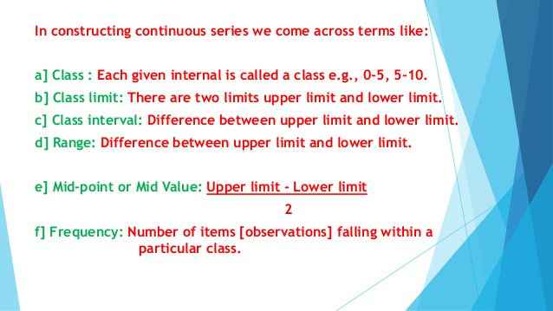

Slide 24
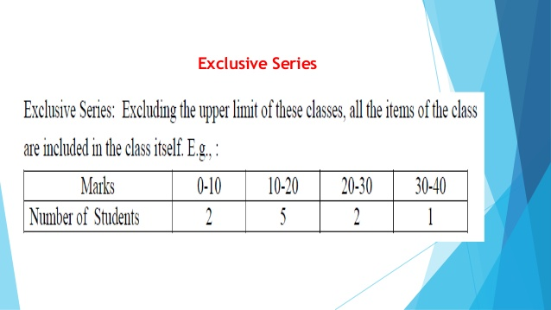

Slide 25
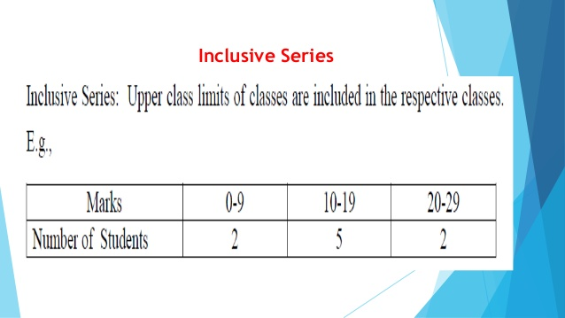

Slide 26
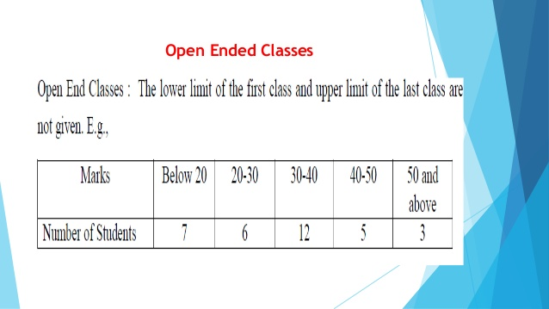

Slide 27
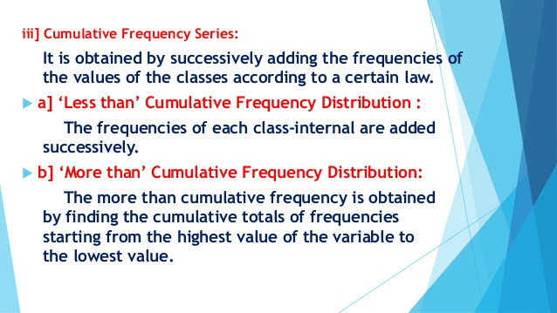

Slide 28
