Slide 1
PROMOTION MANAGEMENT

Slide 2
Promotion in marketing refers to the set of activities that are aimed at communicating and persuading potential customers to purchase a product, service, or idea. It is one of the key elements of the marketing mix, alongside product, price, and place (distribution). Effective promotion is essential for building brand awareness, generating interest, and ultimately driving sales. Promotion strategies can vary widely and may include advertising, personal selling, public relations, direct marketing, and sales promotion.

Slide 3
key components and methods of promotion
Advertising:
  Definition: Paid, non-personal communication through various media channels to promote a product, service, or idea.
  Methods: TV commercials, radio ads, print advertisements, online banners, social media ads, etc.
Personal Selling:
  Definition: Personal communication between a sales representative and a potential buyer to persuade them to make a purchase.
  Methods: Face-to-face selling, telemarketing, video conferencing, etc.
Public Relations (PR):
  Definition: Building and maintaining positive relationships between an organization and its public, including customers, investors, employees, and the media.
  Methods: Press releases, media events, sponsorships, community involvement, etc.
Sales Promotion:
  Definition: Short-term incentives to encourage the purchase or sale of a product or service.
  Methods: Discounts, coupons, free samples, contests, loyalty programs, etc.

Slide 4
Direct Marketing:
  Definition: Direct communication with potential customers to promote products or services without using an intermediary.
  Methods: Email marketing, direct mail, telemarketing, SMS marketing, etc.
Social Media Marketing:
  Definition: Using social media platforms to connect with and engage an audience, build brand awareness, and promote products or services.
  Methods: Creating and sharing content, running targeted ads, interacting with followers, etc.
Content Marketing:
  Definition: Creating and distributing valuable, relevant content to attract and engage a target audience.
  Methods: Blog posts, articles, videos, infographics, podcasts, etc.

Slide 5
Influencer Marketing:
  Definition: Partnering with influencers or individuals with a significant following to promote a product or service.
  Methods: Collaborations with influencers, sponsored content, product placements, etc.
Event Marketing:
  Definition: Promoting a brand, product, or service through in-person or virtual events.
  Methods: Trade shows, product launches, sponsorships, experiential marketing, etc.
Word-of-Mouth Marketing:
  Definition: Encouraging customers to share their positive experiences and recommendations with others.
  Methods: Providing exceptional customer service, referral programs, social sharing incentives, etc.

Slide 6
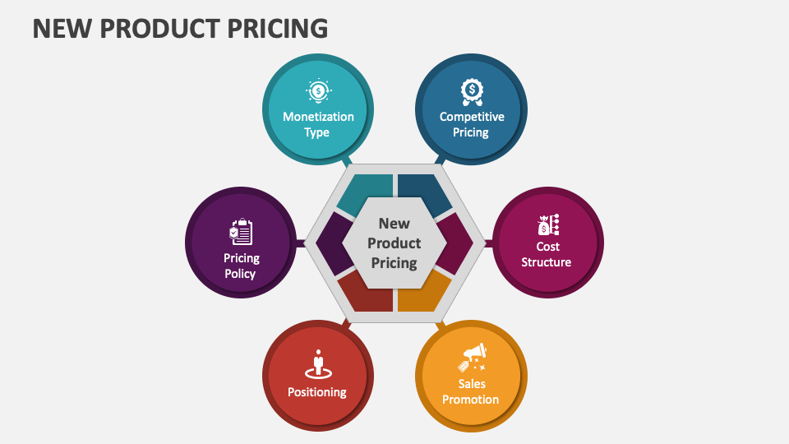

Slide 7

PRICING
Setting the right price for a new product is a critical aspect of the marketing strategy. The pricing decision involves considering various factors such as production costs, market demand, competition, and perceived value. Here are some common strategies and considerations for new product pricing:

Slide 8
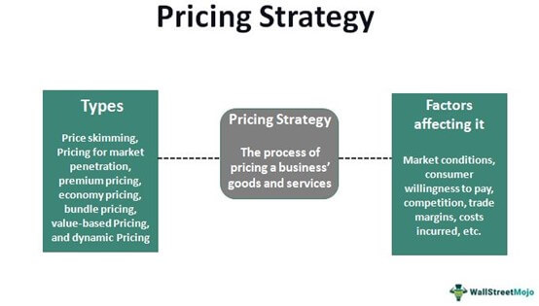

Slide 9
Cost-Based Pricing:
Definition: Cost-based pricing involves setting the selling price of a product by adding a markup to the production cost. The markup is intended to cover both variable costs (directly related to producing each unit) and fixed costs (overhead expenses that do not vary with production levels) and provide a profit margin.
Formula: Selling Price = Cost + (Cost x Markup Percentage)

Slide 10
strategies
Cost-Based Pricing:
  Cost-Plus Pricing: Calculate the production cost per unit and add a markup percentage to determine the selling price. This method ensures that costs are covered and provides a margin for profit.
Market-Oriented Pricing:
  Skimming Pricing: Set an initially high price for a unique or innovative product to capitalize on early adopters or customers willing to pay a premium. The price may be gradually lowered as market demand evolves.
  Penetration Pricing: Set a low initial price to quickly gain market share and attract a large customer base. This strategy aims to discourage competition and increase sales volume.
Value-Based Pricing:
  Perceived Value: Determine the value that customers place on the product and set the price accordingly. This approach focuses on the benefits and value the product provides to customers rather than production costs.
Competitive Pricing:
  Match or Beat Competitors: Set prices in line with or slightly below competitors to appeal to price-sensitive customers. This strategy is common in markets with similar products or services.

Slide 11
Dynamic Pricing:
  Adjust prices based on real-time market conditions, demand, or other factors. This approach is often used in e-commerce and can involve algorithms that change prices dynamically.
Bundle Pricing:
  Offer multiple products or services as a package at a discounted price compared to purchasing each item separately. Bundling can encourage customers to buy more and increase overall revenue.
Discount Pricing:
  Offer temporary discounts or promotional pricing to stimulate initial sales, attract attention, or encourage trial. This is common during product launches or seasonal promotions.

Slide 12
Advantages:
  Simple and straightforward calculation.
  Ensures that all costs are covered.
  Provides a predictable profit margin.
Disadvantages:
  Doesn't consider customer perceptions or market conditions.
  Ignores the willingness of customers to pay based on perceived value.
  May lead to overpricing or underpricing if market conditions change.
Use Cases: Commonly used in industries where production costs are the primary determinant of pricing, such as manufacturing or commodity markets.

