Slide 1
PROMOTION MANGEMENT

Slide 2
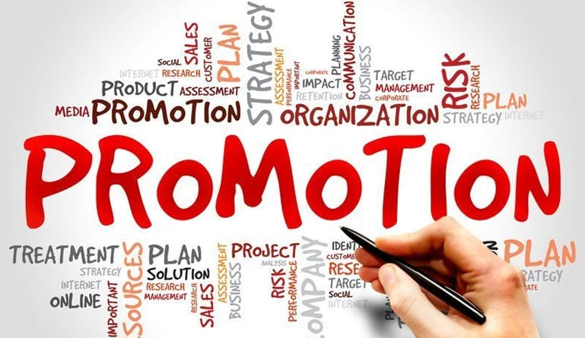
promotion
"promotion" refers to the various activities and efforts undertaken to advertise, sell, and create awareness about a product, service, brand, or company. It is one of the four key elements of the marketing mix, commonly known as the "4Ps," which also include Product, Price, and Place.

Slide 3
Components
Advertising: Paid communication through various media channels such as television, radio, print, online platforms, and social media to reach a wide audience and create brand awareness.
Sales Promotion: Short-term incentives or discounts aimed at encouraging the purchase of a product or service. This includes activities like discounts, coupons, contests, and giveaways.
Public Relations (PR): Building and maintaining a positive image and relationship with the public. PR activities include media relations, community engagement, and managing the overall perception of the brand.

Slide 4
Personal Selling: Direct communication between a sales representative and potential customers. This involves one-on-one interaction to understand customer needs and persuade them to make a purchase.
Direct Marketing: Direct communication with individual customers, often using methods like email marketing, direct mail, and telemarketing. This allows for personalized messages tailored to specific target audiences.
Content Marketing: Creating and distributing valuable content to attract and engage a target audience. This can include blog posts, articles, videos, and other forms of content that provide information and build brand credibility.

Slide 5
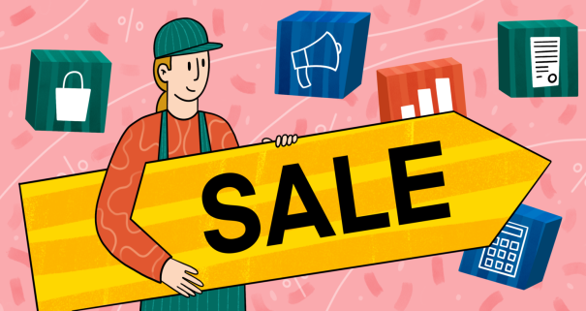
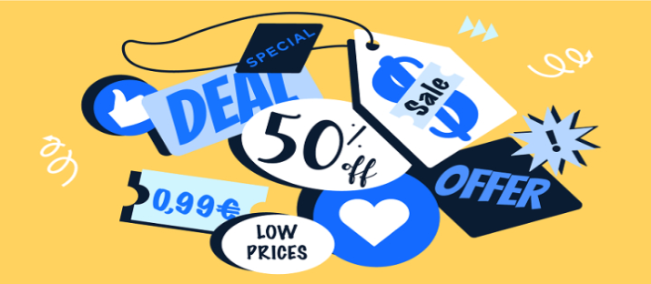
Sales promotion
Sales promotion refers to the set of marketing activities or tactics designed to encourage the purchase of a product or service within a specific period. Unlike advertising, which focuses on long-term brand building, sales promotion is typically used for short-term boosts in sales. Sales promotions can take various forms and are often used in conjunction with other elements of the marketing mix.

Slide 6
sales promotion techniques
Discounts and Price Reductions:
  Offering a temporary reduction in the regular price of a product to stimulate immediate sales. This can include percentage discounts, buy-one-get-one-free (BOGO) offers, or clearance sales.
Coupons:
  Providing customers with a coupon that offers a discount on a particular product or service. Coupons can be distributed through various channels, including print media, online platforms, or mobile apps.
Rebates:
  Offering a refund on a portion of the purchase price after the sale is made. Customers are typically required to submit proof of purchase to receive the rebate.
Contests and Sweepstakes:
  Creating a competitive or game-like environment to engage customers. Contests and sweepstakes often involve prizes or rewards for participants.
Free Samples:
  Distributing free samples of a product to encourage customers to try it before making a purchase. This is common in industries such as food, cosmetics, and personal care.

Slide 7
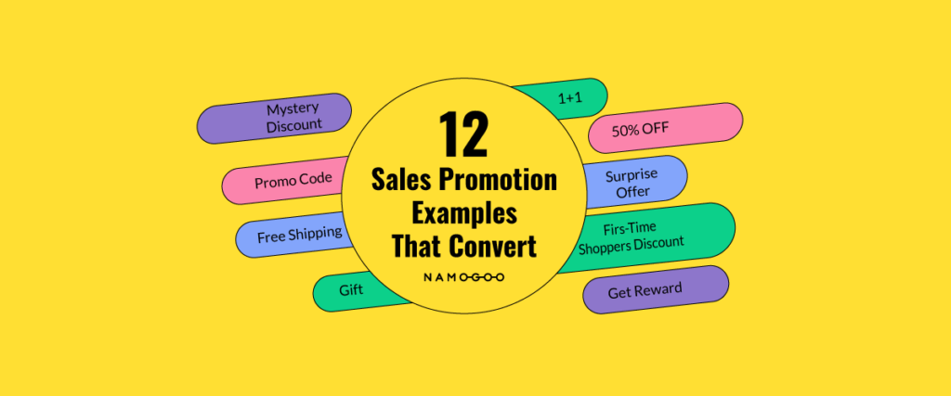

Slide 8
Loyalty Programs:
  Offering rewards or discounts to customers who make repeat purchases or demonstrate brand loyalty. Loyalty programs often involve points or membership tiers.
Flash Sales:
  Limited-time sales events with deeply discounted prices to create a sense of urgency and encourage immediate purchases.
Bundle Offers:
  Combining two or more products or services at a discounted price when purchased together. This encourages customers to buy more items.
Gift with Purchase:
  Providing a free item or gift when a customer makes a purchase. This can incentivize customers to choose one product over another.
Limited-Time Offers:
  Promoting special deals or prices for a short duration, creating a sense of urgency for customers to take advantage of the offer.
Trade-In Promotions:
  Offering discounts or incentives to customers who trade in an old product when purchasing a new one.

Slide 9
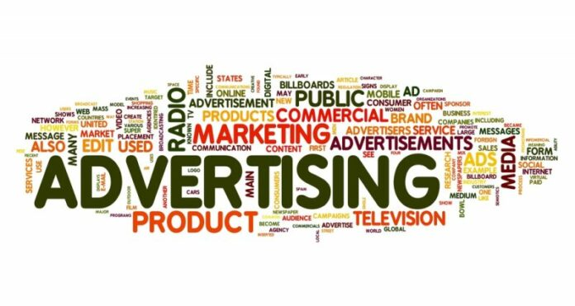
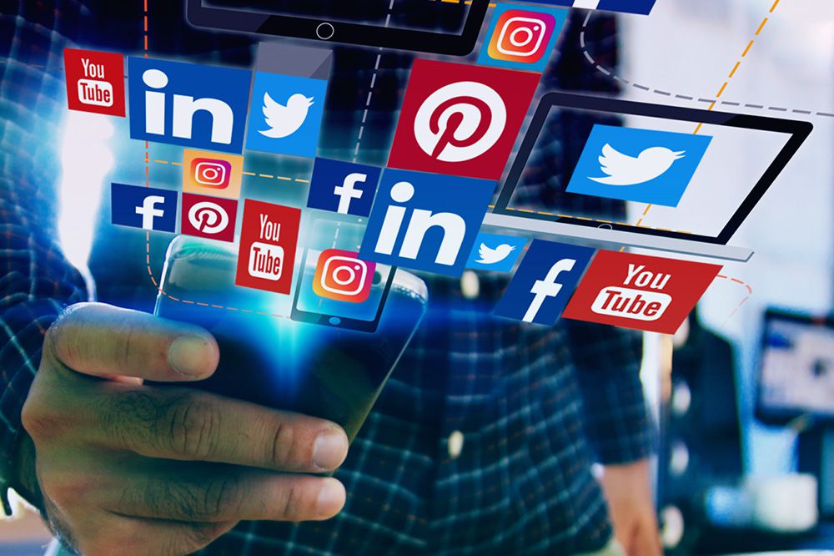
ADVERTISING
Advertising is a marketing communication strategy that aims to promote a product, service, or idea through various media channels to a target audience. The primary goal of advertising is to create awareness, generate interest, and persuade people to take a specific action, such as purchasing a product or service.

Slide 10
Message: The core idea or information that the advertiser wants to convey. This includes the value proposition, features, and benefits of the product or service.
Media: The channels or platforms used to deliver the advertising message. This can include traditional media (television, radio, print) or digital media (online advertising, social media, search engine marketing).
Target Audience: The specific group of people the advertising campaign aims to reach. Understanding the demographics, interests, and behavior of the target audience is crucial for effective advertising.
Creative Elements: The visual and textual elements used in advertisements, including images, graphics, slogans, and other design elements. Creative aspects play a significant role in capturing attention and conveying the brand message.
Budget: The financial resources allocated to the advertising campaign. The budget determines the scope and scale of the advertising efforts.
Campaign Timing: The strategic timing of advertising messages to coincide with specific events, seasons, or promotional periods.
Metrics and Measurement: Methods for evaluating the effectiveness of the advertising campaign. This may include metrics such as reach, impressions, click-through rates (for digital advertising), and return on investment (ROI).

Slide 11
Direct marketing is a form of advertising that communicates directly with consumers through various channels, aiming to generate a response or action. This type of marketing is characterized by its emphasis on individual customer relationships and the ability to measure the effectiveness of campaigns in terms of response rates and customer behavior.

Slide 12
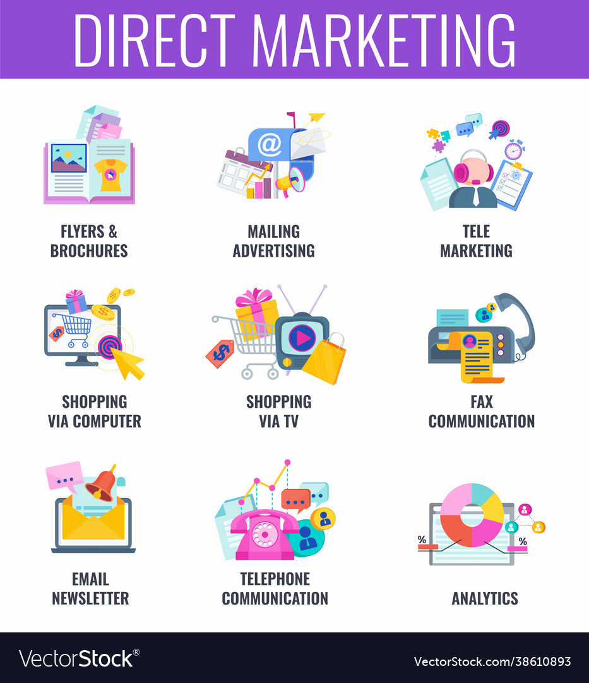

Slide 13
Some common forms of direct marketing
Direct Mail:
  Sending physical promotional materials, such as postcards, catalogs, letters, or brochures, directly to a targeted list of individuals or businesses.
Telemarketing:
  Using telephone calls to reach out to potential customers. Telemarketers may engage in sales pitches, surveys, or other interactions to promote products or services.
Email Marketing:
  Sending targeted messages to a group of people via email. Email marketing can include newsletters, promotional offers, product announcements, and personalized content.
Direct Response Advertising:
  Creating advertisements with a specific call to action, prompting the audience to take immediate action, such as making a purchase, filling out a form, or calling a toll-free number.

Slide 14
Catalog Marketing:
  Distributing printed or digital catalogs showcasing a range of products. Customers can order directly from the catalog using order forms or online platforms.
Text Message Marketing (SMS):
  Sending promotional messages to mobile phone users via text messages. This form of marketing is often used to deliver time-sensitive offers or updates.
Social Media Direct Marketing:
  Leveraging social media platforms to engage with and market to a specific audience. This can involve targeted ads, sponsored posts, and direct messaging.
Database Marketing:
  Using customer databases to segment and target specific groups with personalized messages. This may involve leveraging customer data to tailor offers and communications.

