Slide 1
Personality Development

Slide 2
What is personality development ?
Personal development is an ongoing process of self-improvement either in your career, in your education, in your personal life, or in all of these areas. It is about setting goals for yourself and putting plans in place to reach those goals.

Slide 3


Slide 4
1 – IT FORCES YOU OUT OF YOUR COMFORT ZONE
If there are areas of your job that you do not like, or are not good at, those are the weaknesses that a personal development plan can help you improve on. Confronting these areas and improving on them can help to push you out of your comfort zone. This allows you to experience growth and to improve your skills.

Slide 5
2 – IT DEVELOPS YOUR STRENGTHS
A personal development plan not only helps you to improve on your weaknesses, but it can also help you to develop your strengths. By taking time to focus on nurturing and using your strengths more, you go from being good at something to being excellent at it. You can reach your potential and achieve great growth by developing the skills you are already good at.

Slide 6
3 – IT BOOSTS YOUR CONFIDENCE
Making the decision to improve on your skills takes you a step closer to feeling more confident. Once you have achieved a certain goal, gained another skill, or developed a certain area of your life, you naturally feel good about yourself. The more you keep on developing in the areas of your life you are not confident in, the more you can boost your confidence.

Slide 7
4 – IT IMPROVES YOUR SELF-AWARENESS
Personal development is closely linked to self-awareness. It gives you the opportunity to take an honest look at the areas of your life that need improvement. Through this process, you get to know who you really are, what your true values are, and where you would like to go in life. Once you go through this process, you will improve your self-awareness and experience fulfillment.

Slide 8
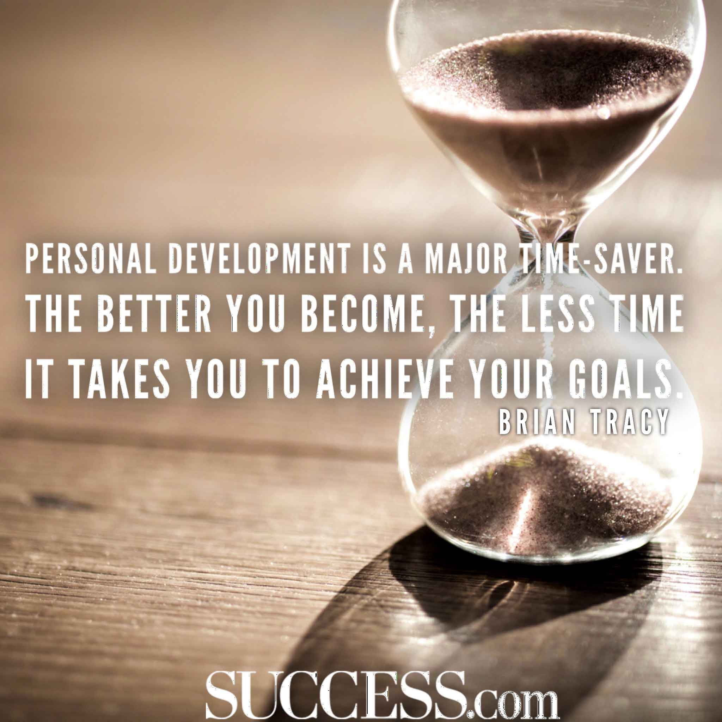

Slide 9
Here are 7 useful tips that will help you in working on your personality:
Study Your Own Self
Excellent Communication Skills
Body Language Depicts Your Attitude
Bringing In Your Own Opinion
Proper Planning For Best Performance
Be A Patient Listener

Slide 10
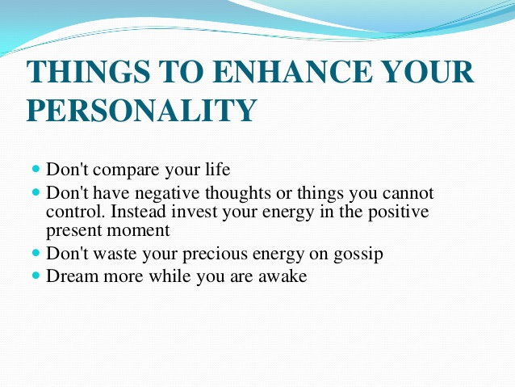

Slide 11
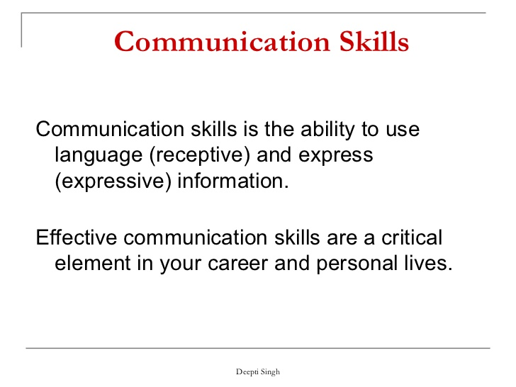

Slide 12
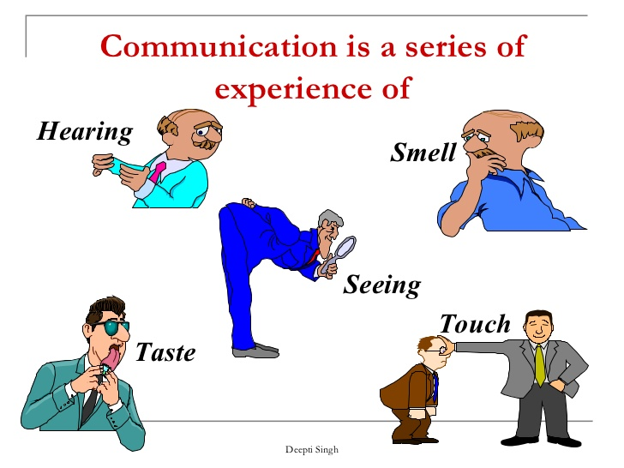

Slide 13
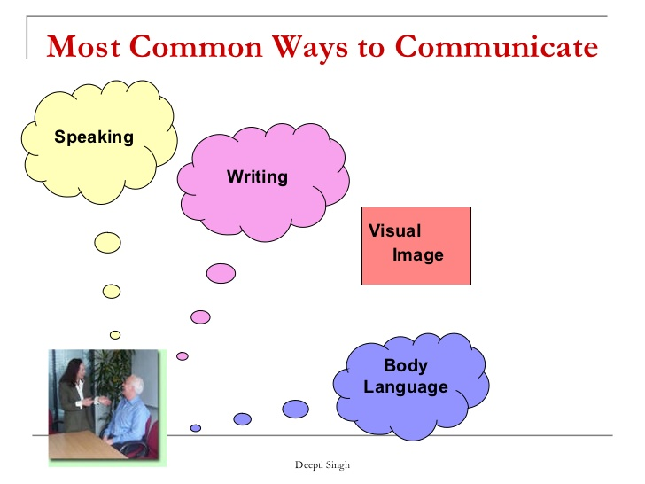

Slide 14
HOW TO INTORDUCE YOURSELF
Thanking you for the giving opportunity to introduce my self.
Name
Place
Experience
Educational Qualification
Technical Qualification
Strength
Achievement
Interest
Family baground

