Slide 1
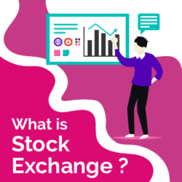
Meaning of Stock Exchange
A stock exchange is an important factor in the capital market. It is a secure place where trading is done in a systematic way. Here, the securities are bought and sold as per well-structured rules and regulations. Securities mentioned here includes debenture and share issued by a public company that is correctly listed at the stock exchange, debenture and bonds issued by the government bodies, municipal and public bodies.
Typically bonds are traded Over-the-Counter (OTC), but a few corporate bonds are sold in a stock exchange. It can enforce rules and regulation on the brokers and firms that are enrolled with them. In other words, a stock exchange is a forum where securities like bonds and stocks are purchased and traded. This can be both an online trading platform and offline (physical location).

Slide 2
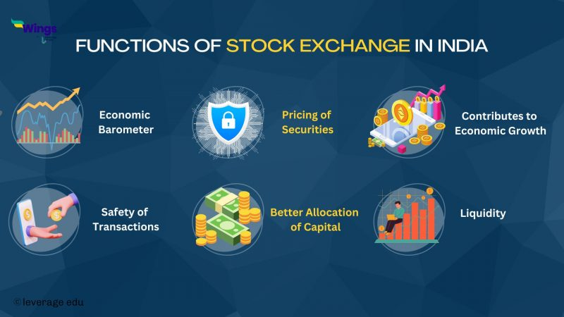

Slide 3

Functions of Stock Exchange
Role of an Economic Barometer: Stock exchange serves as an economic barometer that is indicative of the state of the economy. It records all the major and minor changes in the share prices. It is rightly said to be the pulse of the economy, which reflects the state of the economy.
Valuation of Securities: Stock market helps in the valuation of securities based on the factors of supply and demand. The securities offered by companies that are profitable and growth-oriented tend to be valued higher. Valuation of securities helps creditors, investors and government in performing their respective functions.
Transactional Safety: Transactional safety is ensured as the securities that are traded in the stock exchange are listed, and the listing of securities is done after verifying the company’s position. All companies listed have to adhere to the rules and regulations as laid out by the governing body.
Contributor to Economic Growth: Stock exchange offers a platform for trading of securities of the various companies. This process of trading involves continuous disinvestment and reinvestment, which offers opportunities for capital formation and subsequently, growth of the economy.

Slide 4
Making the public aware of equity investment: Stock exchange helps in providing information about investing in equity markets and by rolling out new issues to encourage people to invest in securities.
Offers scope for speculation: By permitting healthy speculation of the traded securities, the stock exchange ensures demand and supply of securities and liquidity.
Facilitates liquidity: The most important role of the stock exchange is in ensuring a ready platform for the sale and purchase of securities. This gives investors the confidence that the existing investments can be converted into cash, or in other words, stock exchange offers liquidity in terms of investment.
Better Capital Allocation: Profit-making companies will have their shares traded actively, and so such companies are able to raise fresh capital from the equity market. Stock market helps in better allocation of capital for the investors so that maximum profit can be earned.
Encourages investment and savings: Stock market serves as an important source of investment in various securities which offer greater returns. Investing in the stock market makes for a better investment option than gold and silver.

Slide 5


Definition of Red Herring Prospectuses
1
Legal Documents 📄
2
Regulatory Requirement 📝
A red herring prospectus is a preliminary version of a company's prospectus, containing information about its operations, management, and finances.
It is a mandatory document that needs to be filed with the Securities and Exchange Board of India (SEBI) before an initial public offering (IPO) can occur.

Slide 6

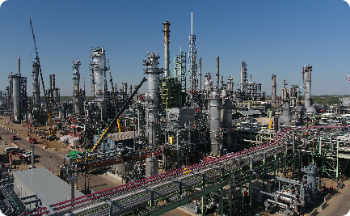

Examples of Red Herring Prospectuses
Technology Startups
Energy Sector
Hospitality Industry
Red herring prospectuses are commonly used by innovative tech startups looking to raise capital for their expansion and growth plans.
Large energy companies often release red herring prospectuses when planning major infrastructure projects or acquisitions.
Restaurant chains and hotels also publish red herring prospectuses when seeking funds for new locations or renovations.

Slide 7
Common Characteristics of Red Herring Prospectuses
1
Executive Summary
A concise overview of the company's purpose, industry position, and financial highlights.
Business Operations
2
Detailed information on products or services, markets, distribution channels, and competition.
3
Financial Data
Comprehensive analysis of revenue, expenses, cash flow, assets, and liabilities, including historical performance and future projections.
Risk Factors
4
Identification and assessment of potential risks, such as industry volatility, regulatory changes, and competition.

Slide 8

Difference Between Equity and Debt Market
Equity Market
Debt Market
Ownership in the company is obtained through shares.
Investors lend money to the company in exchange for fixed interest payments.
Participate in the company's growth and profit-sharing.
Receive regular interest payments and the principal amount upon maturity.
Higher risk and potential for high returns.
Lower risk and generally lower returns.

Slide 9

SEBI and Its Objectives
Securities and Exchange Board of India (SEBI)
Objectives of SEBI
To protect the interests of investors
A regulatory authority that supervises and regulates the securities market in India.
To promote fair and transparent securities markets
To regulate and develop the securities market

Slide 10

ESOP (Employee Stock Ownership Plan)
1
Incentivizing Employees
2
Retention and Motivation
ESOPs provide employees the opportunity to own a stake in the company, aligning their goals with its success.
By granting employees stock options, companies can retain top talent and motivate them to contribute to the company's growth and profitability.

Slide 11
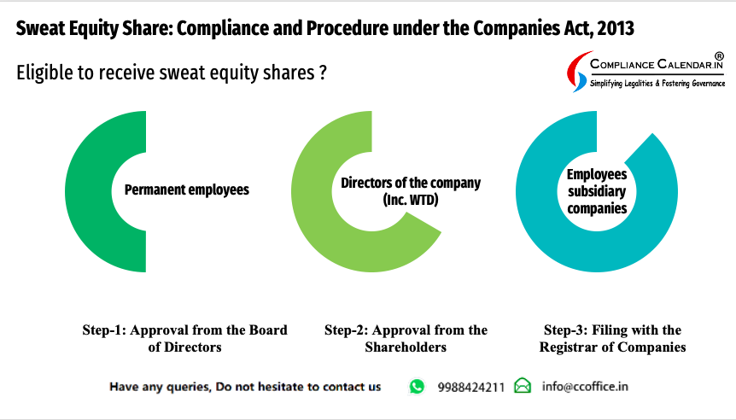
Sweat Equity
Sweat equity refers to the effort put in by an individual or a company in the form of physical or intellectual work, rather than monetary investment, to increase the value of a project or asset.

Slide 12
How Stock Exchanges Work
1
Listed Companies
Companies list their shares on stock exchanges, allowing investors to buy and sell them in the secondary market.
Market Orders
2
Investors place buy or sell orders, which are matched by the exchange to facilitate seamless transactions.
3
Price Discovery
The constant buying and selling of shares leads to price fluctuations, reflecting the market's perception of a company's value.

Slide 13
Types of Stock Exchanges
1
National Exchanges
2
Regional Exchanges
These exchanges serve as primary platforms for trading stocks of companies within a specific country.
Catering to specific geographic areas, regional exchanges provide local companies with a platform to access capital markets.
3
Electronic Exchanges
Digital platforms like NASDAQ have revolutionized stock trading, offering fast and accessible markets.

Slide 14


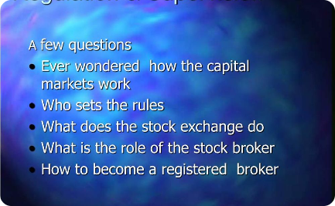
Market Participants
Traders
Investors
Regulators
Professional traders execute buy and sell orders on behalf of themselves, clients, or institutions.
Individuals and institutions invest in stocks for long-term wealth accumulation and income generation.
Government bodies and regulatory agencies oversee stock exchanges to maintain fair and transparent markets.

Slide 15

Trading Strategies on Stock Exchanges
1
Day Trading
Short-term traders aim to profit from intraday price movements, capitalizing on market volatility.
Value Investing
2
Investors seek undervalued stocks, with the belief that their true value will be recognized over time.
3
Growth Investing
Investors target stocks of companies with high growth potential, expecting future earnings expansion.

Slide 16

Regulations and Oversight
Securities and Exchange Commission (SEC)
Financial Conduct Authority (FCA)
The SEC oversees U.S. stock exchanges, protecting investors and ensuring fair market practices.
The FCA regulates stock exchanges in the United Kingdom, promoting market integrity and consumer protection.
International Organizations
Bodies like IOSCO work towards global coordination and standardization of securities regulations.

Slide 17
Primary and Secondary Market
Primary Market
Newly issued securities are sold directly by companies to investors, raising capital for expansion.
Secondary Market
Investors buy and sell existing securities among themselves, allowing for liquidity and price discovery.

Slide 18

IPO and FPO
1
IPO (Initial Public Offering)
2
FPO (Follow-on Public Offering)
Companies go public by offering shares to the public for the first time, often generating significant interest among investors.
Companies with already listed shares issue additional shares for sale, providing an opportunity for expansion or reducing debt.

