Slide 1
Product management
By usha jaya prakash

Slide 2
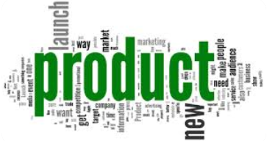
Product
product refers to the overall idea, design, and features that constitute a tangible or intangible offering that fulfills a need or want and is intended for exchange in the market. Products can take various forms, including physical goods, services, or a combination of both.

Slide 3
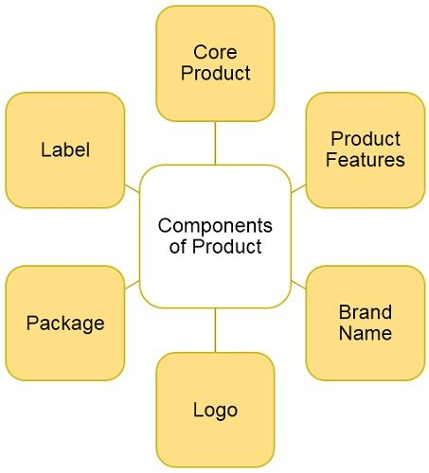

Slide 4
Key elements of product
Value Proposition:
  A product should offer a value proposition, addressing a specific need or solving a problem for the target audience. The value proposition is the unique combination of features and benefits that sets the product apart from competitors.
Features and Specifications:
  Products have specific features and specifications that define their functionality, appearance, and performance. These characteristics contribute to the overall user experience.
Design and Packaging:
  The design of a product, including its aesthetics and usability, plays a crucial role in attracting and retaining customers. Packaging is also an important aspect, influencing perceptions and providing information about the product.

Slide 5
Branding:
  The brand associated with a product contributes to its identity and reputation. Branding encompasses elements such as logos, slogans, and the overall image that consumers associate with the product.
Lifecycle:
  Products go through a lifecycle that typically includes introduction, growth, maturity, and decline phases. Understanding this lifecycle helps businesses make informed decisions about marketing, production, and strategy.
Quality and Durability:
  The quality of a product is a critical factor in customer satisfaction. Durability, reliability, and performance contribute to the perceived value of the product.

Slide 6
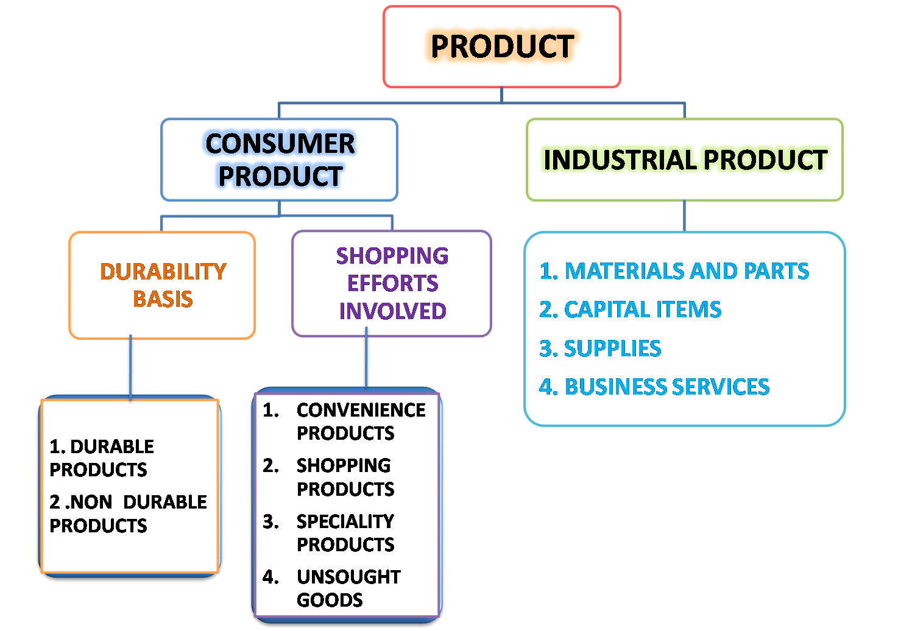

Slide 7
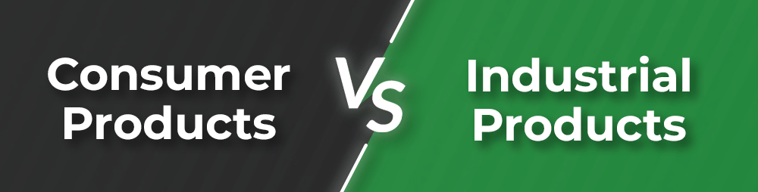
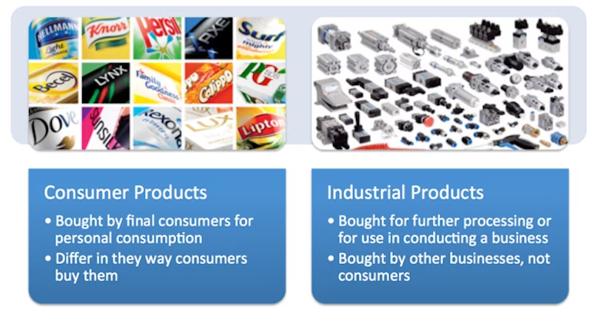

Slide 8
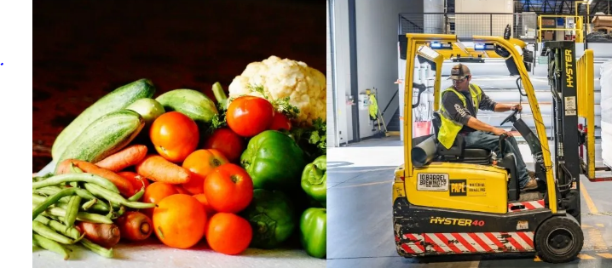

Slide 9
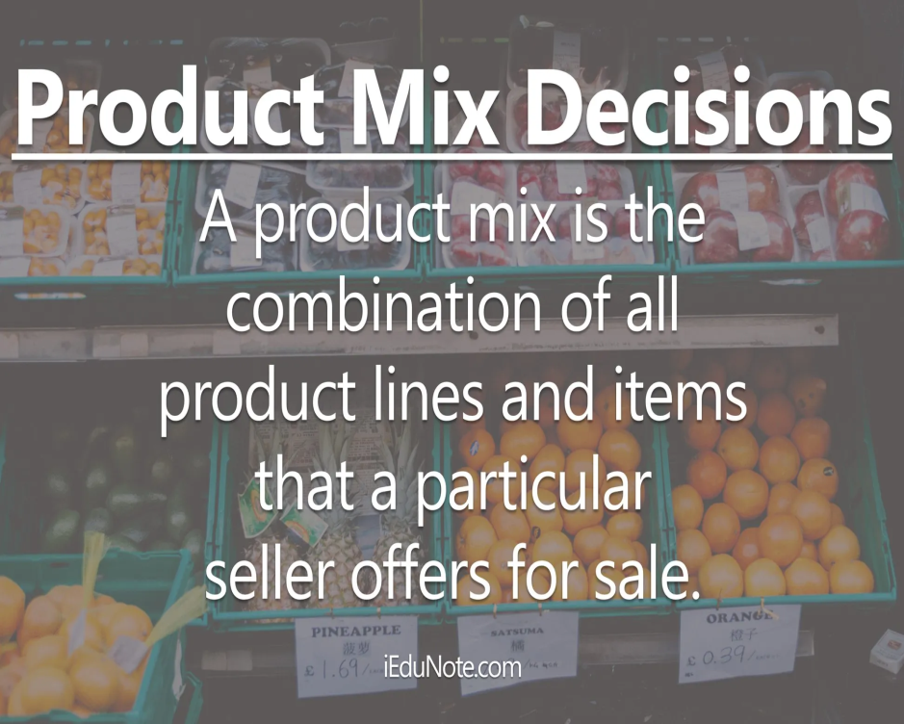
Product mix decisions
Product mix decisions involve managing a company's portfolio of products to optimize market success and profitability. A product mix typically consists of various product lines, each containing different products. Here are some key product mix decisions

Slide 10

Product Line Length:
  Definition: The number of products within a specific product line.
  Example: A smartphone company offering various models with different specifications, screen sizes, and price points.
Product Line Width:
  Definition: The variety of different product lines a company offers.
  Example: An electronics company offering smartphones, laptops, tablets, and smartwatches.
Product Line Depth:
  Definition: The number of product variants within a specific product category.
  Example: A car manufacturer offering a specific model with various options such as engine sizes, colors, and features.
Product Line Length:
  Definition: The number of products within a specific product line.
  Example: A Smartphone company offering various models with different specifications, screen sizes, and price points.
Product Line Width:
  Definition: The variety of different product lines a company offers.
  Example: An electronics company offering smartphones, laptops, tablets, and smartwatches.
Product Line Depth:
  Definition: The number of product variants within a specific product category.
  Example: A car manufacturer offering a specific model with various options such as engine sizes, colors, and features.

Slide 11
Product Mix Length:
  Definition: The total number of products a company offers across all its product lines.
  Example: An apparel company offering a wide range of clothing items, including shirts, pants, dresses, and outerwear.
Product Mix Depth:
  Definition: The total number of variants offered for each product in a company's product mix.
  Example: A cosmetics company offering a particular lipstick product in various colors, finishes, and formulations.

Slide 12
Product Line Consistency:
  Definition: The relatedness of the various product lines within a company.
  Example: An outdoor clothing company expanding its product mix to include hiking gear and accessories, maintaining consistency with its core outdoor lifestyle theme.
Product Mix Width:
  Definition: The total number of different product lines a company offers.
  Example: A beverage company offering a product mix that includes soft drinks, energy drinks, bottled water, and juices.
Product Mix Consistency:
  Definition: The degree to which product lines are related in terms of use, production, distribution, or branding.
  Example: An electronics company maintaining consistency in its product mix by offering smart phones, smart watches, and wireless earbuds, all integrated with a common ecosystem.

Slide 13
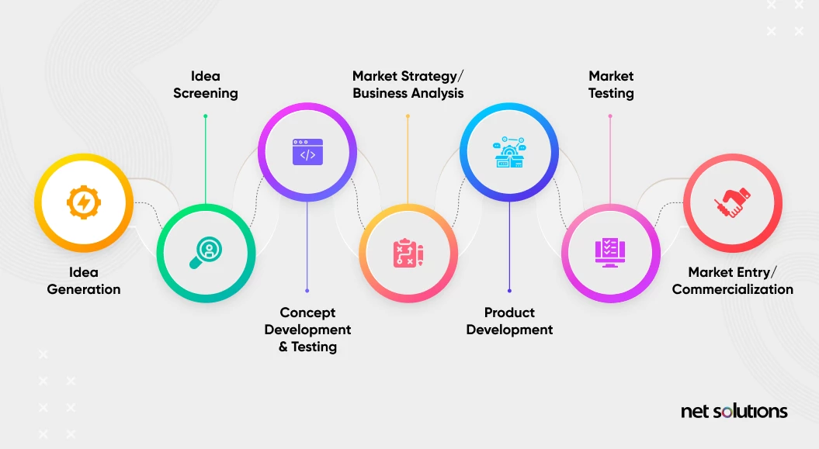
New product development stages

Slide 14
New product development (NPD) is a systematic process that involves a series of stages from idea generation to commercialization. Here is an overview of the typical stages in new product development:
Idea Generation:
  Description: This stage involves the systematic search for new product ideas. Ideas can come from various sources, including customers, employees, competitors, and research.
  Activities: Brainstorming sessions, market research, customer feedback, trend analysis.
Idea Screening:
  Description: In this stage, the generated ideas are evaluated to identify the most promising ones. Criteria such as market potential, technical feasibility, and alignment with organizational goals are considered.
  Activities: Feasibility analysis, initial concept testing, idea prioritization.
.

Slide 15
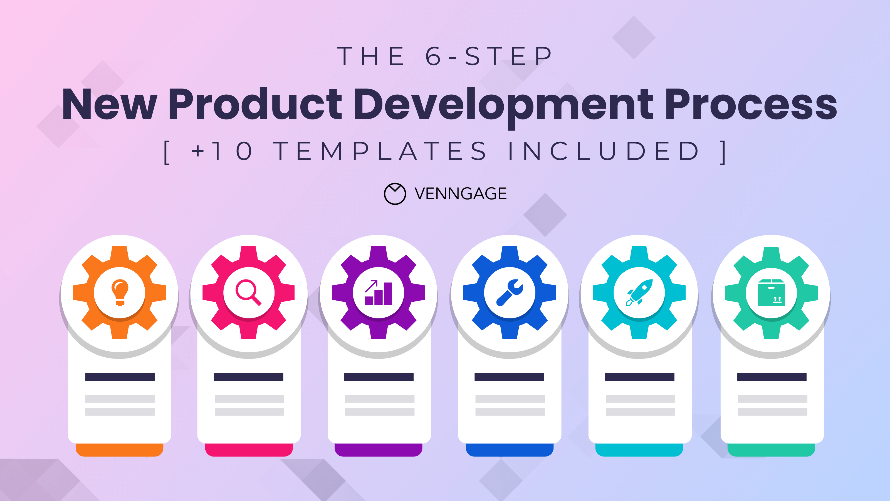

Concept Development and Testing:
  Description: Detailed concepts are developed for the selected ideas. These concepts are then tested with potential consumers to gather feedback and assess their reactions.
  Activities: Concept creation, prototyping, consumer surveys, focus groups.
Business Analysis:
  Description: A thorough analysis of the business viability of the product is conducted. This includes assessing costs, revenue projections, market demand, and potential return on investment.
  Activities: Financial analysis, market research, cost estimation, risk assessment

Slide 16
Product Development:
  Description: The actual development of the product takes place during this stage. Design, engineering, and manufacturing processes are executed to create a prototype or initial version of the product.
  Activities: Product design, prototyping, testing, manufacturing.

Slide 17
Test Marketing:
  Description: A limited-scale launch of the product is conducted in a specific market to observe real-world consumer behavior, gather feedback, and identify any issues before a full-scale launch.
  Activities: Limited product release, market testing, monitoring consumer response.
Commercialization:
  Description: The full-scale launch of the product into the market occurs during this stage. Marketing, distribution, and sales efforts are intensified to make the product widely available.
  Activities: Full-scale production, marketing campaigns, distribution setup, sales promotion.

Slide 18
Launch and Post-Launch Evaluation:
  Description: The product is officially introduced to the market. Post-launch evaluation involves monitoring sales, customer feedback, and overall performance.
  Activities: Performance monitoring, customer feedback analysis, post-launch review.
Product Maintenance and Improvement:
  Description: Ongoing efforts are made to support, maintain, and enhance the product based on customer feedback, emerging trends, and technological advancements.
  Activities: Customer support, continuous improvement, updates or upgrades.
It's important to note that these stages are often depicted as a linear process, but in reality, they may be iterative with feedback loops between stages. The success of new product development depends on effective cross-functional collaboration, market responsiveness, and adaptability to changing circumstances throughout the process.

Slide 19
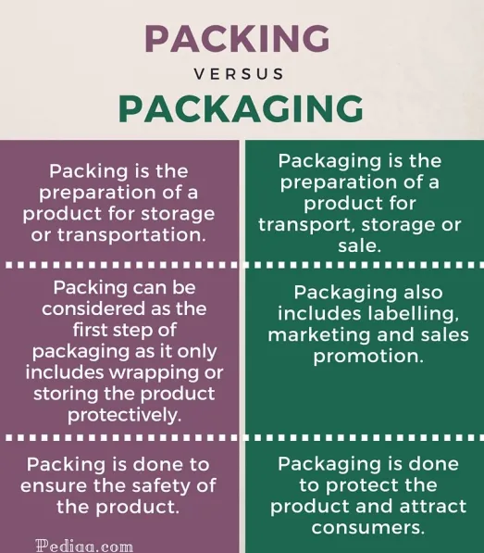

Slide 20
