Slide 1
ACCONTS RECEIVABLE
AND
PAYABLE MANAGEMENT

Slide 2
INTRODUCTION
Accounts receivable is a current asset account that keeps track of money that third parties owe to you. Again, these third parties can be banks, companies, or even people who borrowed money from you. One common example is the amount owed to you for goods sold or services your company provides to generate revenue.

Slide 3
Accounts payable is a current liability account that keeps track of money that you owe to any third party. The third parties can be banks, companies, or even someone who you borrowed money from. One common example of accounts payable are purchases made for goods or services from other companies. Depending on the terms for repayment, the amounts are typically due immediately or within a short period of time.

Slide 4
t is important to note the significance of balancing your assets and liabilities and stockholders’ equity in accounting. The significance of the balance can be explained by the basic accounting equation: Assets = Liabilities + Stockholders’ Equity. One can also rearrange the equation to better suit their preferences.

Slide 5
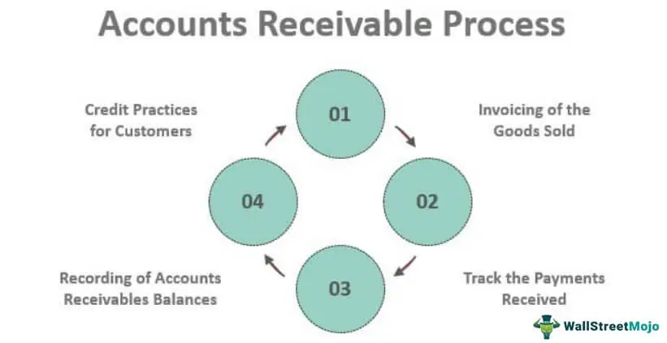

Slide 6
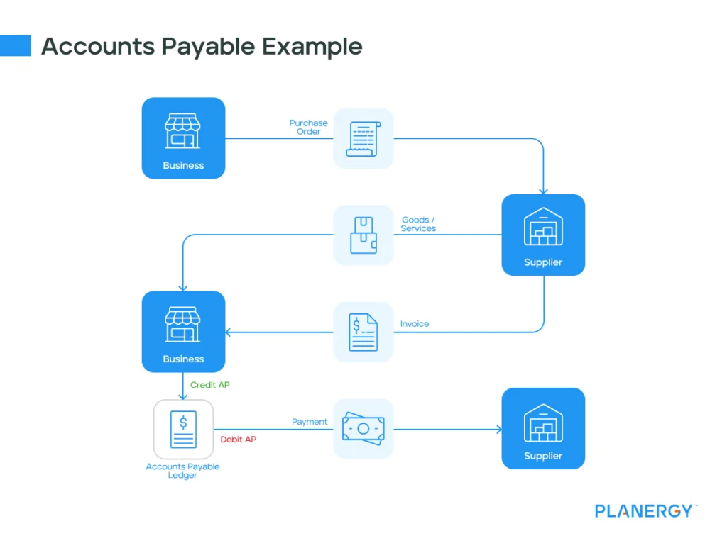

Slide 7
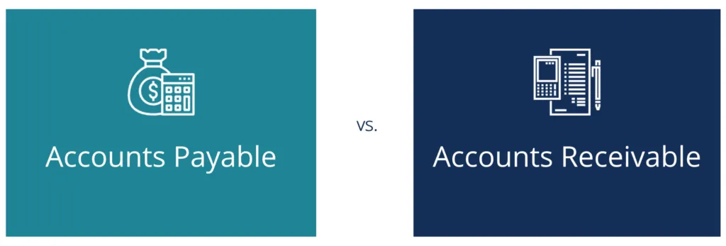

Slide 8
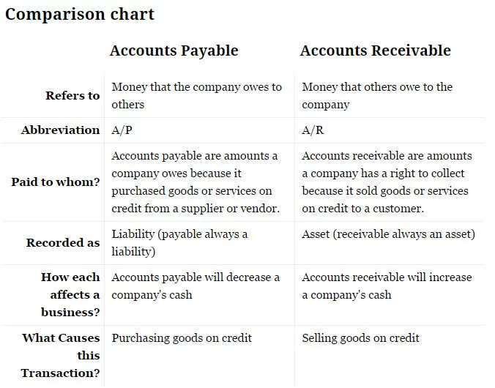

Slide 9
BILL WISE DETAILS
Tally provides a very useful option to maintain bill wise details. Every business man buy and sell goods on credit. So he has to maintain details of all the debtors and creditors from whom amount is due or to whom amount is payable.
Bill wise details in tally. Erp9 is a function that helps to track the details credit sales or credit purchases
Bill details (sundry debtors / sundry creditors) of all receivable and payable of bills from the party ( for example, acceptance of Bill, Payment of Bill, Pending Bill, Overdue Bill, etc. ) you can use this option.

Slide 10
Sundry Creditors
Sundry Creditors means that whenever we purchase any goods from our business by borrowing from a Party / Company / Firm, we know that Party / Company in the accounting language as Sundry Creditors. All such people come under Sundry Creditors, from whom we buy goods on credit in business and those who have to pay us are called Sundry Creditors
Sundry creditors represent a liability on the company's balance sheet, indicating an obligation to pay in future.

Slide 11
Sundry debtors
A person who receives goods or services from a business in credit or does not make the payment immediately and is liable to pay the business in the future is called a Sundry Debtor.
Businesses use an account to track these transactions and they are called as Sundry Debtor account or Accounts Receivable.
sundry debtors represent an asset on the company's balance sheet, signifying money receivable from others.

Slide 12
CHANGING ACCOUNTING PERIOD
you can just change the period and you are ready to start bookkeeping for the new financial year in the same Company data that you have been using so far. This also enables you to compare the reports from different financial years.
We recommend starting fresh series of voucher numbering for your New Financial Year by restarting the voucher numbers for all applicable voucher types used in your business. This helps implement a fresh set of numbering for your books in each financial year and manage your outstanding.
Go to Gateway of Tally > Press Alt+F2 (F2: Period) and enter the dates.

Slide 13
ACTIVATION
OF
BILL WISE DETAIL
IN
TALLY ERP.9

Slide 14

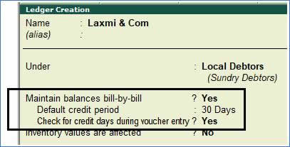
if you have Set Maintain Bill-wise details to Yes in F11: Features > F1: Accounting Features.

Slide 15
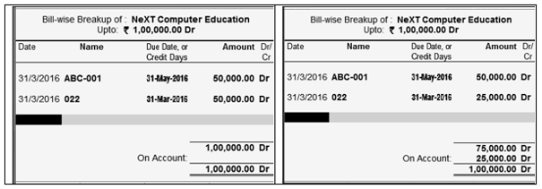
Maintained Bill by Bill or Bill wise. Normally, this option is useful for Ledgers falling under Sundry Debtors & Sundry Creditors.
If you set this option to Yes, while entering the opening balance in the Opening Balance field at the end of Ledger Creation screen and press Enter, the Bill-wise Breakup screen of the Ledger created is displayed as shown.

Slide 16
TYPES OF BILL WISE DETAILS
Advance : This method is used for payment without any previous due arisen to the party.
Against Ref : Is used for adjustment against any existing dues.
New Ref : Is used for creating any dues.
On Account : For lump sum amount.

Slide 17
TYPES OF BILL WISE DETAILS
There are four types of bill wise detail.
New Reference
This is used at the time of passing sales and purchase entries which will later serve for Against reference entries to be passed under Sundry debtors and creditors ledger.
Against Reference
This reference is used when we pass receipt entries or payment entries against the references created at the time of passing of original entries such as sales and purchase.
There are four types of bill wise detail.
New Reference
This is used at the time of passing sales and purchase entries which will later serve for Against reference entries to be passed under Sundry debtors and creditors ledger.
Against Reference
This reference is used when we pass receipt entries or payment entries against the references created at the time of passing of original entries such as sales and purchase.
Advance
This reference is used when any amount is received in advance for any services rendered or for any outward supplies of goods is made or when any amount is paid in advance for purchases to be made at the future date.
In other words, this type of bill wise detail is maintained where the nature of service or nature of product or terms of business demands advance receipts/ advance payments to be made and to track these when the business gets materialized at the time of raising of bill or invoice, these entries would serve as reference.
On Account
An interest receipt entry, interest payment entries uses these types of references. But apart from these, this type of reference is also used when we are unsure of as of against which bill the sum has been settled by the debtor.
So, all those types of entries are kept under this reference till the time it gets cleared as to which Invoice the sum relates to.

Slide 18
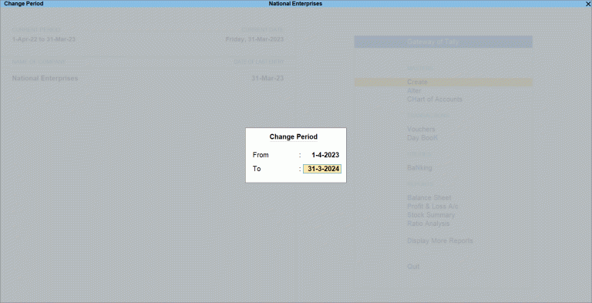

Slide 19
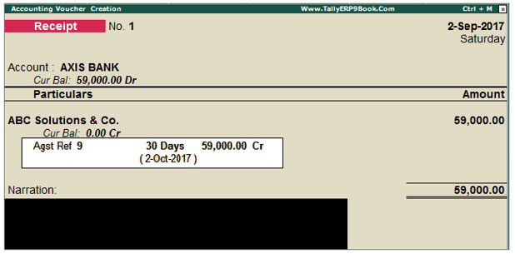

Slide 20
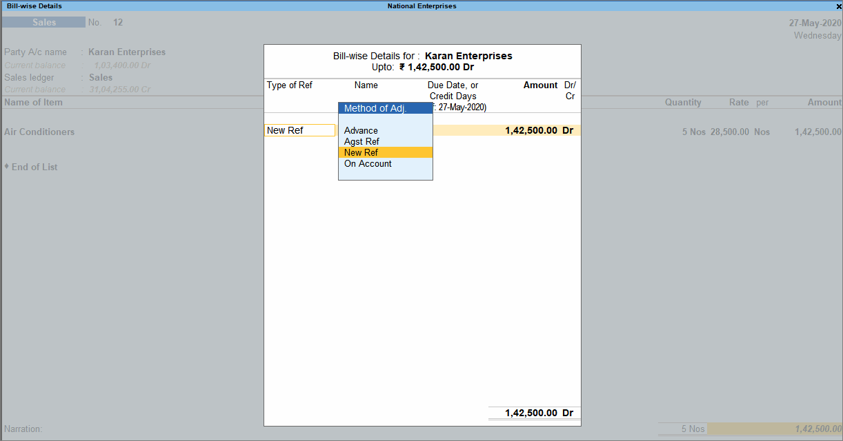

Slide 21
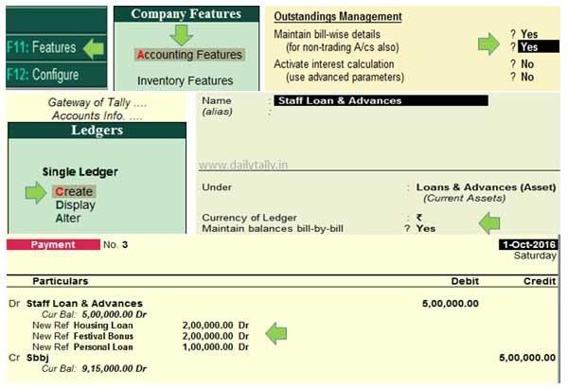

Slide 22
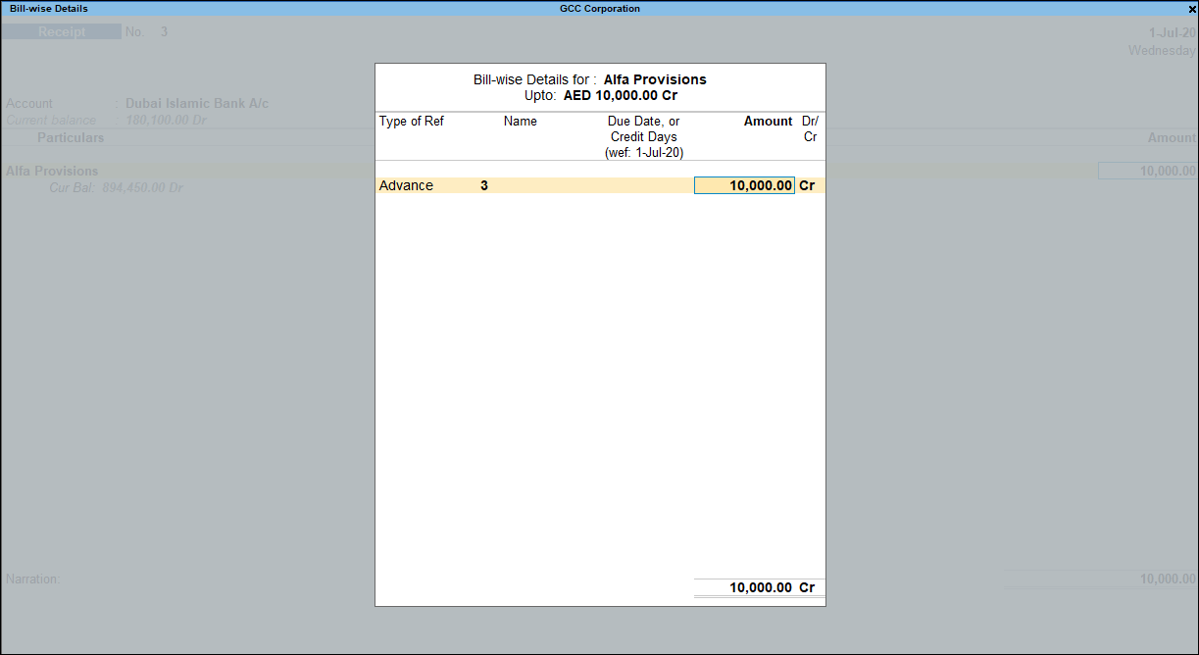

Slide 23
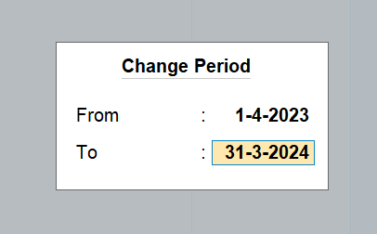
To change the current period, Go to Gateway of Tally > click F2: Period and enter the dates.

Slide 24
Splitting company data
If you choose to separate your previous financial year into a different company, split company data will be helpful. Ideally, it is performed when the closure activities, such as analysis, audits, all adjustments, etc., in books of the previous financial year, are completed.
To ensure the split activity is smooth, you need to perform the data verification process before splitting. This automatically detects possible errors in the data.
Click on 'Data' available in the top menu> Split > Verify Data
Select the company you want to split
If there are any errors, the list will be shown for you to correct it
To split the company data, again click on 'Data' available in the top menu >Split > Split Data >Select Company. Once you’ve selected the company, enter the date in the Split From field (Ideally, the new financial year date) and press Enter.

Slide 25
