Slide 1

RG KEDIA COLLEGE OF COMMERCE
Name of the faculty:M.Mounika
Course:BBA
Year: IIIrd
Subject:Advertising,personal Selling & Sales Promotion

Slide 2
Advertising, Personal Selling & sales Promotion

Slide 3
Unit -I
Promotion Mix
A promotion mix is a set of different marketing approaches that marketers develop to optimize promotional efforts and reach a broader audience. The marketer’s task is to find the right promotion mix for a particular brand.

Slide 4
For instance, it is necessary to identify your target audience , work out a budget that you can afford for a promotion, and decide the most efficient marketing channels for your audience.
A promotion mix is a more expanded approach towards one of five elements of the marketing mix — Promotion. Other factors are people, product, place, and price.

Slide 5
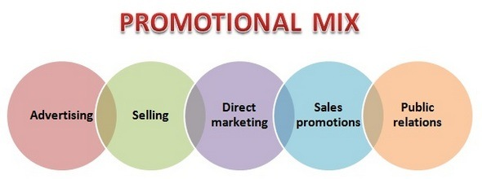

Slide 6
Advertising is the paid presentation and promotion of ideas, goods, or services by an identified sponsor in a mass medium. Examples include print ads, radio, television, billboard, direct mail, brochures and catalogs, signs, in-store displays, posters, mobile apps, motion pictures, web pages, banner ads, emails.

Slide 7
Personal selling is the process of helping and persuading one or more prospects to purchase a good or service or to act on any idea through the use of an oral presentation, often in a face-to-face manner or by telephone. Examples include sales presentations, sales meetings, sales training and incentive programs for intermediary salespeople, samples, and telemarketing.

Slide 8
Sales Promotion is media and non-media marketing communication used for a pre-determined limited time to increase consumer demand, stimulate market demand or improve product availability. Examples include coupons, sweepstakes, contests, product samples, rebates, tie-ins, self-liquidating premiums, trade shows, trade-ins, and exhibitions.

Slide 9
Public relations or publicity is information about a firm's products and services carried by a third party in an indirect way. This includes free publicity as well as paid efforts to stimulate discussion and interest.

Slide 10
Direct Marketing is a channel-agnostic form of advertising that allows businesses and nonprofits to communicate directly to the customer, with methods such as mobile messaging, email, interactive consumer websites, online display ads, fliers, catalog distribution, promotional letters, and outdoor advertising.

Slide 11
Objective of promotion Mix
Awareness
Knowledge
Liking
Preference
Conviction
Purchase

Slide 12
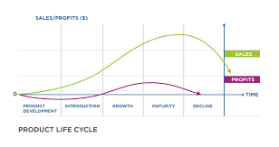
Factors Effecting Promotion Mix
Stages of Product Life cycle

Slide 13
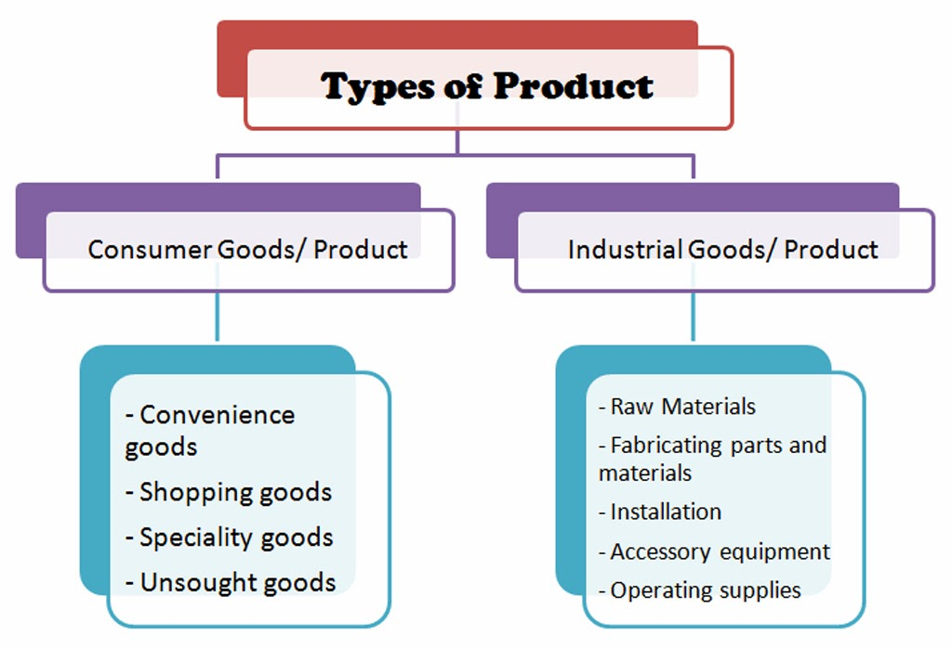

Slide 14
Target of promotion
Promotional to
Wholesale
Promotional to Retailers
Promotional to Industrial
Promotion to final customers

Slide 15
Size of the budget
Depends upon the budget we can select promotional tools. If the high budget we can choose TV and Radio.

Slide 16
Push strategy
A push marketing strategy, also called a push promotional strategy, refers to a strategy in which a firm attempts to take its products to consumers – to “push” them onto consumers. ... Push marketing strategies are commonly used to gain and increase product exposure.

Slide 17
Pull strategy
A pull promotional strategy uses advertising to build up customer demand for a product or service. For example, advertising children's toys on children's television shows is a pull strategy.

Slide 18
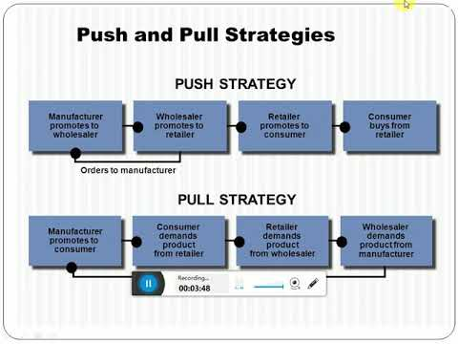

Slide 19
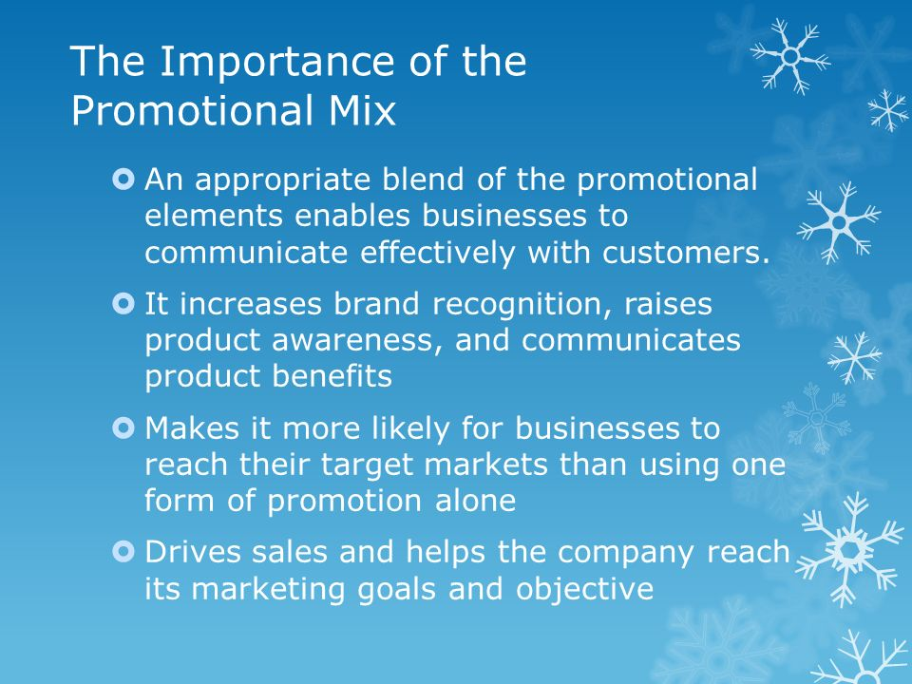

Slide 20
Define Advertisement?
According to RICHARD BUSKIRK Advertisement is a paid form o f non personal presentation of ideas ,goods or services by an identified sponsor.

Slide 21
Feature of Advertisement
Tools for Market Promotion
Non Personal
Paid form
Varied Objectives
Forms of Advertising
Use of media
Wide Applicability

Slide 22
Personal Selling
personal selling is also known as face-to-face selling in which one person who is the salesman tries to convince the customer in buying a product. They locate and develop new customers and communicate information about the company, its products, and services.

Slide 23
Features of Personal Selling
Personal Form
Development of Relationship
Flexibility
Direct Feedback
Minimum Wastage

