Slide 1
BUSINESS
ECONOMICS

Slide 2
Business Economics-
Business Economics, also called Managerial Economics, is the application of economic theory and methodology to business.
Business involves decision-making. Decision making means the process of selecting one out of two or more alternative courses of action.

Slide 3
Microeconomics vs. Macroeconomics
Economics is divided into two categories: microeconomics and macroeconomics. Microeconomics is the study of individuals and business decisions, while macroeconomics looks at the decisions of countries and governments.
Microeconomics deals with various issues like demand, supply, factor pricing, product pricing, economic welfare, production, consumption, and more. Macroeconomics deals with various issues like national income, distribution, employment, general price level, money, and more.

Slide 4
Utility, Total Utility, Marginal Utility
Utility is the degree of satisfaction or pleasure a consumer gets from an economic act. In, other words utility is defined as the want satisfying power of a commodity
Total utility is the sum of utility derived from different units of a commodity consumed by a household.
Marginal Utility is the utility derived from the additional unit of a commodity consumed. The change that takes place in the total utility by the consumption of an additional unit of a commodity is called marginal utility
Marginal utility is the enjoyment a consumer gets from each additional unit of consumption. It calculates the utility beyond the first product consumed. If you buy a bottle of water and then a second one, the utility gained from the second bottle of water is the marginal utility.

Slide 5
What Is the Law of Diminishing Marginal Utility?
The law of diminishing marginal utility means that as you use or consume more of something, you will get less satisfaction from each additional unit of that thing.

Slide 6
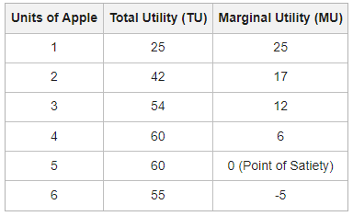
Law of Diminishing marginal utility

Slide 7
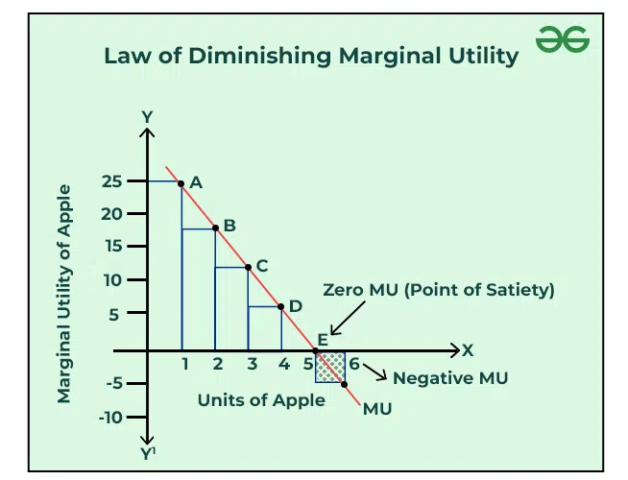
Diminishing Marginal Utility

Slide 8
KEY TAKEAWAYS
The law of diminishing marginal utility says that the marginal utility from each additional unit declines as consumption increases.
The marginal utility can decline into negative utility, as it may become entirely unfavorable to consume another unit of any product.
The marginal utility may decrease into negative utility, as it may become entirely unfavorable to consume another unit of any product.

Slide 9
The law of diminishing marginal utility makes several assumptions:
The goods being consumed are identical.
The units are consumed quickly with few breaks in between.
Units are not too big or too small.
The consumer's taste is constant.
There is no change in the price of the goods or of their substitutes.
The unit can be measured.
The consumer is making rational decisions about consumption.

Slide 10
Marginal utility (MU) is equal to the change in the total utility (TU) divided by the change in quantity consumed (Q). This is written as MU = ΔTU / ΔQ.
Businesses can use the law of diminishing marginal utility to understand consumer behavior, price their goods and services, and diversify their offerings.
The law of diminishing marginal utility affects how businesses price their goods and services. Because the first quantity of something has the most utility, consumers are usually willing to pay more for it.
The exceptions to the law of DMU, where this law doesn't apply: This law is valid only for uniform units of a commodity, which are same in shape, size, length, etc. The law applies only in cases when the consumer doesn't change his taste and fashion of the commodity remains same, which hardly is the case. Like hobbies, reading, money, and music and poetry.

Slide 11
Law of Equi-Marginal Utility
Law of Equi-Marginal Utility explains the relation between the consumption of two or more products and what combination of consumption these products will give optimum satisfaction. Marginal Utility is the additional satisfaction gained by consuming one more unit of a commodity.
Regarding this Prof. Marshall has said that – “If a person has a thing which he can put to several uses he will distribute it among these uses in such a way that it has the same marginal utility in all.”

Slide 12
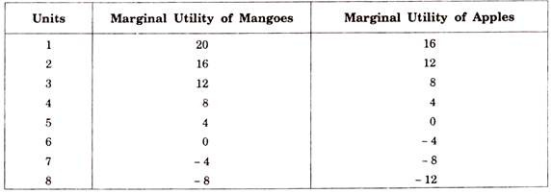
This can be explained by the following table:
The utility of the 3rd unit of mangoes is 12 and that of 4th unit of apples is 4.

Slide 13
Assumptions of Law of Equi-Marginal Utility
Units of goods are homogenous.
No time gap between the consumption of the different units.
Tastes, fashion, preferences, and priorities remain unchanged.
Consumer aims at maximum satisfaction.
Consumer’s income is fixed and limited.
Explanation of the Law
In order to get maximum satisfaction out of the funds we have, we carefully weigh the satisfaction obtained from each rupee ‘had we spend If we find that a rupee spent in one direction has greater utility than in another, we shall go on spending money on the former commodity, till the satisfaction derived from the last rupee spent in the two cases is equal.
In other words, we substitute some units of the commodity of greater utility for some units of the commodity of less utility. The result of this substitution will be that the marginal utility of the former will fall and that of the latter will rise, till the two marginal utilities are equalized. That is why the law is also called the Law of Substitution or the Law of Equi-marginal Utility.

Slide 14
Suppose further that we have got seven rupees to spend. Let us spend three rupees on oranges and four rupees on apples. What is the result? The utility of the 3rd unit of oranges is 6 and that of the 4th unit of apples is 2. As the marginal utility of oranges is higher, we should buy more oranges and fewer apples. Let us substitute one orange for one apple so that we buy four oranges and three apples. Now the marginal utility of both oranges and apples is the same, i.e., 4.
This arrangement yields maximum satisfaction. The total utility of 4 oranges would be 10 + 8 + 6 + 4 = 28 and of three apples 8 + 6 + 4= 18 which gives us a total utility of 46. The satisfaction given by 4 oranges and 3 apples at one rupee each is greater than could be obtained by any other combination of apples and oranges.
In no other case does this utility amount to 46. We may take some other combinations and see.

Slide 15
UNITS | MARGINAL UTILITY OF ORANGES | MARGINAL UTILITY OF APPLES
1 | 10 | 8
2 | 8 | 6
3 | 6 | 4
4 | 4 | 2
5 | 2 | 0
6 | 2 | -2
7 | -2 | -4
8 | -4 | -6

Slide 16
Let the purchase spend MN money (one rupee) more on apples and the same amount of money, N’M'( = MN) less on oranges. The diagram shows a loss of utility represented by the shaded area LN’M’P’ and a gain of PMNE utility. As MN = N’M’ and PM=P’M’, it is proved that the area LN’M’P’ (loss of utility from reduced consumption of oranges) is bigger than PMNE (gain of utility from increased consumption of apples). Hence the total utility of this new combination is
We then conclude that no other combination of apples and oranges gives as great a satisfaction to the consumer as when PM = P’M’, i.e., where the marginal utilities of apples and oranges purchased are equal, with given amour, of money at our disposal.

Slide 17
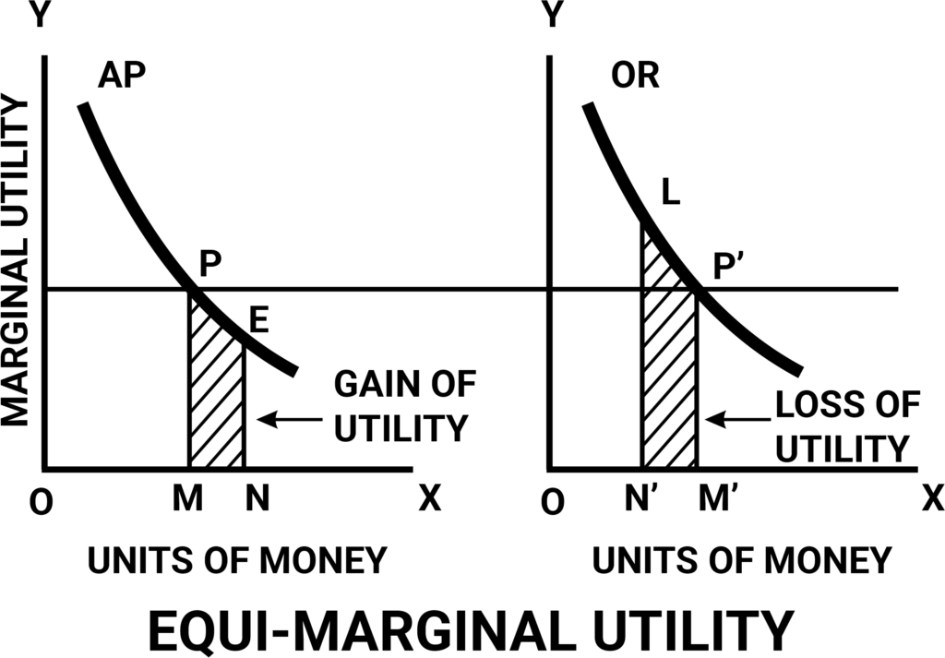

Slide 18
Limitations of the Law of
Equi-Marginal Utility
Ignorance
Inefficient Organization
Unlimited Resources
Hold of Custom and Fashion
Frequent Changes in Prices.

