Slide 1
CHANNEL MANAGEMENT AND
RETAILING

Slide 3
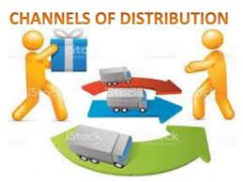
Channel distribution
Channel distribution, also known as distribution channels or marketing channels, refers to the process by which a product or service is made available to the end consumer. It involves a series of intermediaries or middlemen that facilitate the movement of goods from the manufacturer to the consumer.

Slide 4
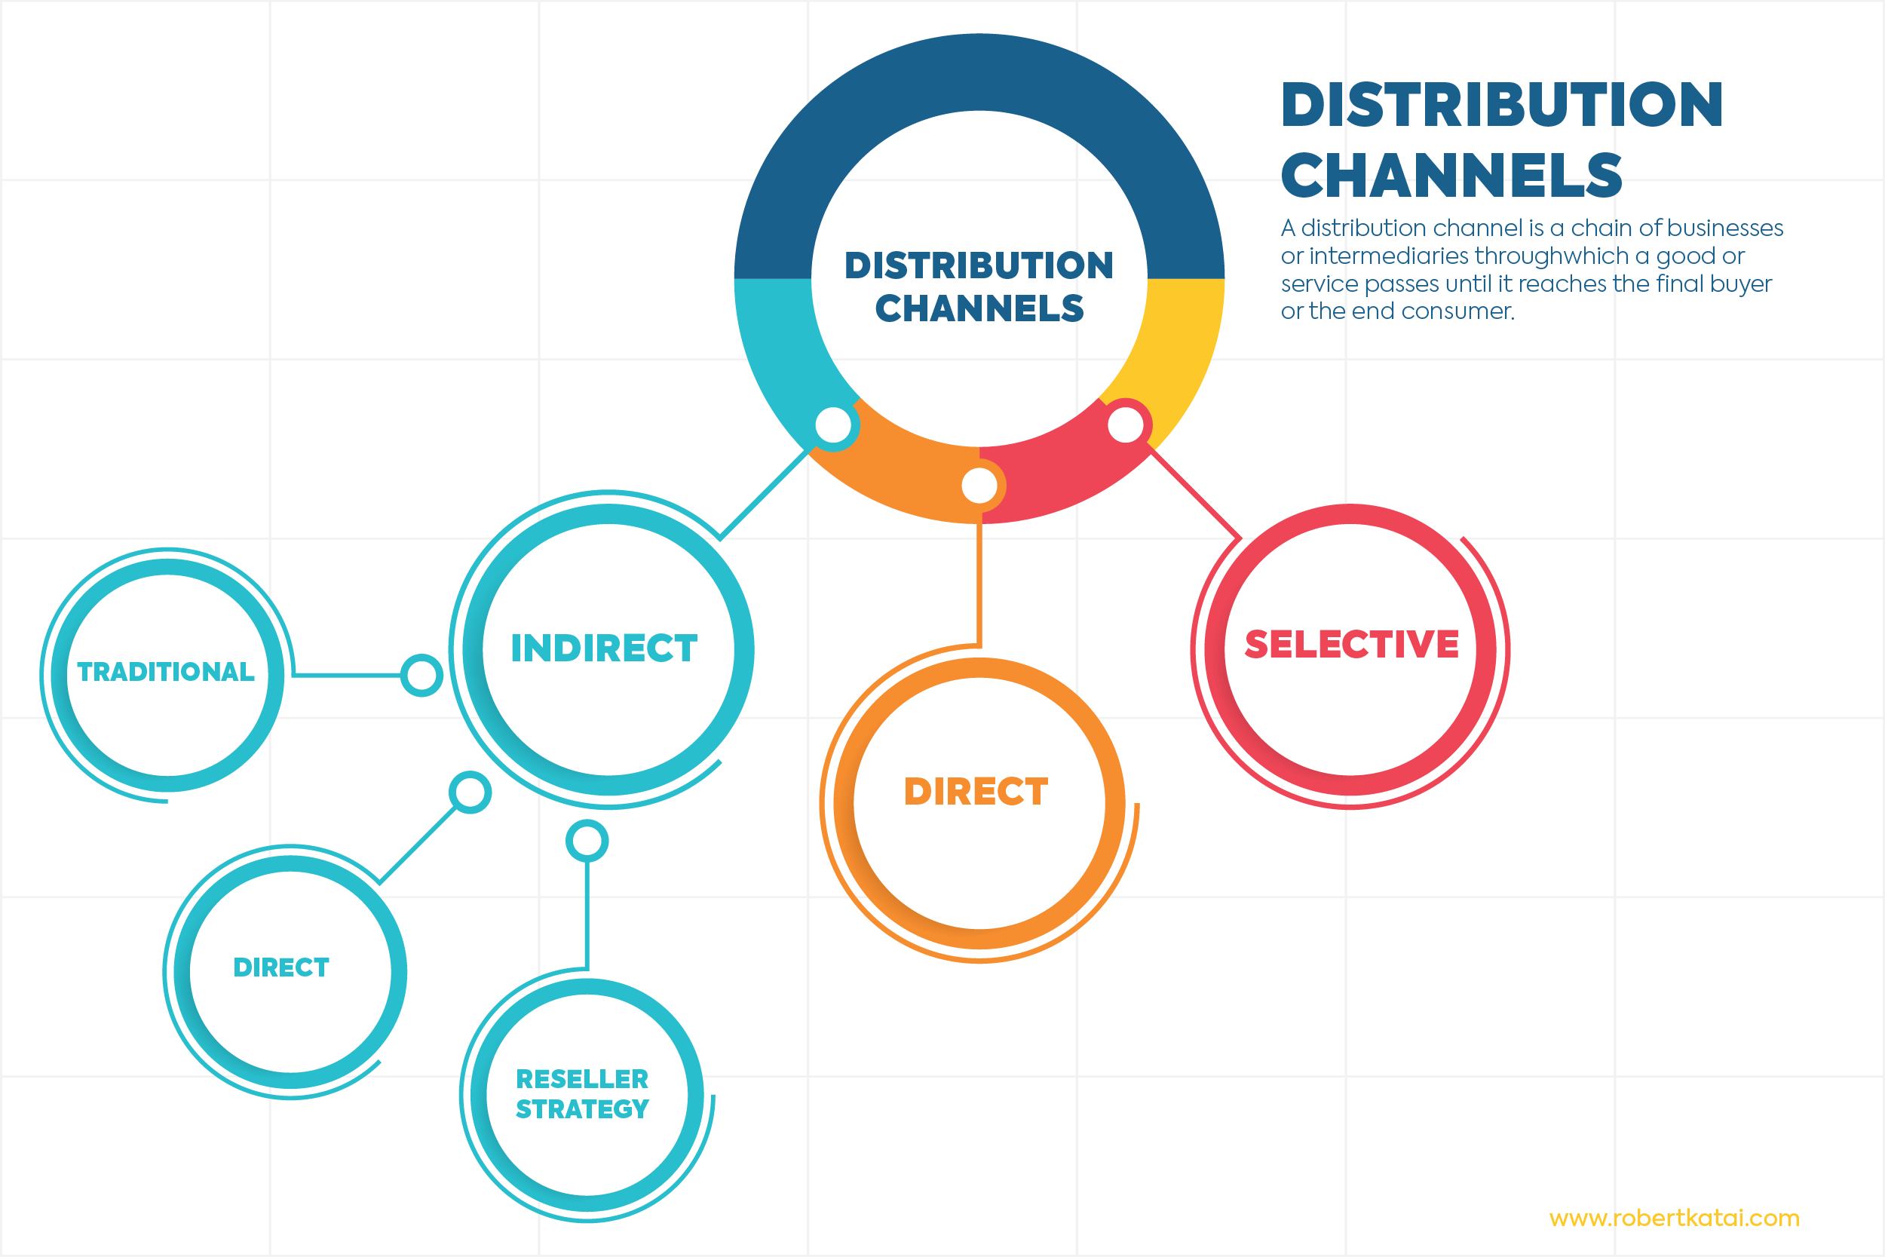

Slide 6
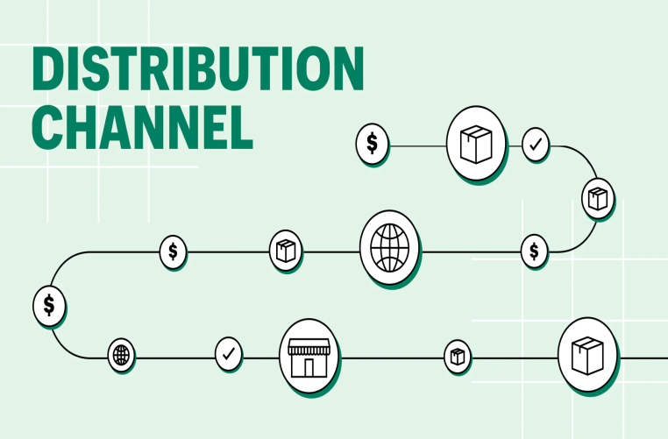
There are several types of distribution channels, and companies may use one or a combination of these channels based on their product, target market, and business objectives. Here are some common types of distribution channels:
Direct Distribution:
  The product goes directly from the manufacturer to the consumer without any intermediaries.
  This can be achieved through company-owned stores, e-commerce websites, or direct sales representatives.

Slide 7
Indirect Distribution:
  Involves intermediaries between the manufacturer and the consumer.
  Examples of intermediaries include wholesalers, retailers, and agents.
Retail Distribution:
  Products are sold directly to consumers through retail outlets.
  Retailers can be brick-and-mortar stores, online retailers, or a combination of both.
Wholesale Distribution:
  Involves selling products in large quantities to retailers or other businesses.
  Wholesalers act as intermediaries between manufacturers and retailers.

Slide 8
Online Distribution:
  Involves selling products through online channels, such as e-commerce websites.
  Can include both direct-to-consumer sales and sales through online retailers.
Agent or Broker Distribution:
  Involves using agents or brokers to represent the manufacturer and sell products on their behalf.
  Common in industries where specialized knowledge or relationships are crucial.
Dual Distribution:
  Involves using multiple channels to reach the target market.
  For example, a company may sell products both through its own stores and through third-party retailers.

Slide 9
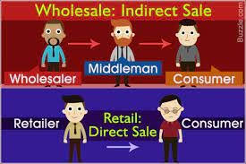

Slide 10
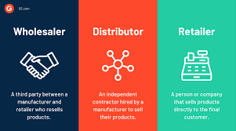
A wholesaler is a business or individual that buys goods in large quantities from manufacturers or producers and sells smaller quantities to retailers. Wholesalers act as intermediaries in the distribution channel, facilitating the movement of goods from the point of production to the point of sale.

Slide 11

Marketing intermediaries,
Marketing intermediaries, also known as middlemen or intermediaries, play crucial roles in the distribution channel by facilitating the movement of goods and services from producers to consumers. These intermediaries can include wholesalers, retailers, agents, and distributors. Here are some key functions of marketing intermediaries:
Distribution:
  Intermediaries help move products from producers to consumers by establishing efficient distribution channels. They play a vital role in physically transferring goods, managing inventory, and ensuring timely delivery.
Promotion:
  Intermediaries play a role in promoting products. This can include point-of-sale displays, advertising, and other promotional activities. Retailers, in particular, contribute to the promotion of products by showcasing them to consumers.
Marketing intermediaries, also known as middlemen or intermediaries, play crucial roles in the distribution channel by facilitating the movement of goods and services from producers to consumers. These intermediaries can include wholesalers, retailers, agents, and distributors. Here are some

Slide 12
key functions of marketing intermediaries:
Distribution:
  Intermediaries help move products from producers to consumers by establishing efficient distribution channels. They play a vital role in physically transferring goods, managing inventory, and ensuring timely delivery.
Matching:
  Intermediaries match the diverse needs and preferences of consumers with the varied offerings of producers. By offering a range of products in one place, such as a retail store, intermediaries provide consumers with choices.
Negotiation:
  Intermediaries often negotiate terms and conditions between producers and retailers. This includes price negotiations, quantity discounts, and other aspects of the business transaction.
Financing:
  Intermediaries may provide financing services to both producers and retailers. For example, wholesalers may offer credit terms to retailers, and retailers, in turn, may extend credit to consumers.

Slide 13
Information:
  Intermediaries gather market information and share insights with producers and retailers. This information can include consumer preferences, market trends, and competitor activities.
Logistics and Transportation:
  Intermediaries are responsible for managing the logistics and transportation of goods. This involves coordinating the movement of products from manufacturers to warehouses, and then to retailers and, ultimately, to consumers.
Storage and Warehousing:
  Intermediaries, especially wholesalers, provide storage and warehousing facilities for products. This is important for managing inventory levels and ensuring a steady supply of goods to retailers.
After-Sales Service:
  Some intermediaries are involved in providing after-sales services, such as repairs or maintenance. This can be particularly relevant for products that require ongoing support.
Market Access:
  Intermediaries provide producers with access to a wider market by reaching consumers in different geographic locations. This is especially beneficial for small producers who may not have the resources to reach a broad audience on their own.

Slide 14
Matching:
  Intermediaries match the diverse needs and preferences of consumers with the varied offerings of producers. By offering a range of products in one place, such as a retail store, intermediaries provide consumers with choices.
Negotiation:
  Intermediaries often negotiate terms and conditions between producers and retailers. This includes price negotiations, quantity discounts, and other aspects of the business transaction.
Financing:
  Intermediaries may provide financing services to both producers and retailers. For example, wholesalers may offer credit terms to retailers, and retailers, in turn, may extend credit to consumers.
Risk Taking:
  Intermediaries assume certain risks associated with carrying inventory. This includes the risk of changes in demand, market fluctuations, and the risk of products becoming obsolete.

Slide 15
Key characteristics of wholesalers
Bulk Purchases: Wholesalers buy products in large quantities, taking advantage of economies of scale to get lower prices per unit.
Distribution: They play a vital role in the distribution process by supplying products to retailers, who then sell them to end consumers.
Warehousing: Wholesalers typically have warehouses to store the large quantities of goods they purchase before distributing them to retailers.
Breaking Bulk: Wholesalers often break down large quantities of goods into smaller, more manageable units for retailers.
Supply Chain Management: They are involved in logistics, transportation, and supply chain management to ensure a smooth flow of products from manufacturers to retailers.
Wholesalers help bridge the gap between producers and retailers, providing a more efficient way to distribute goods in the market. They offer benefits to both manufacturers (by enabling them to sell in larger quantities) and retailers (by providing a convenient source for a variety of products).

