Slide 1


What is a Commercial Bank?
A commercial bank is a financial institution that provides various banking services, such as accepting deposits, offering loans, and providing financial services to individuals, businesses, and governments.

Slide 2
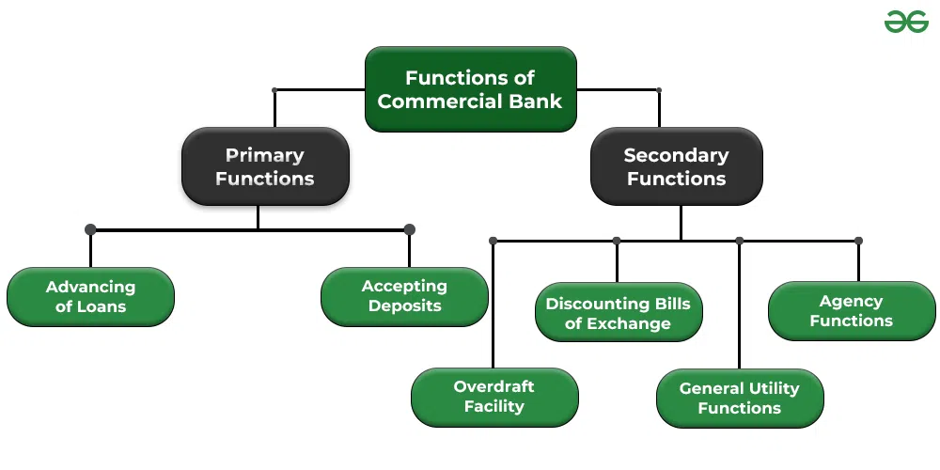

Slide 3
Types of Banks
Venture Capital Banks
Non-Banking Financial Companies (NBFCs)
Banks that provide capital and financial expertise to start-up companies and entrepreneurs.
Financial institutions that offer banking services without holding a full banking license.
Correspondent Banks
Investment Banks
Banks that assist individuals, corporations, and governments in raising capital by underwriting, issuing, and selling securities.
Banks that provide services on behalf of another financial institution in a different location, facilitating international banking transactions.

Slide 4
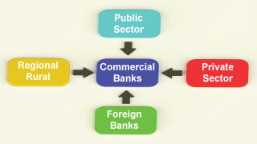

Slide 5
Functions of Commercial Banks
1
Taking Deposits
Commercial banks provide a safe place for individuals and businesses to deposit their money, which can earn interest over time.
2
Providing Loans
Banks lend money to individuals, businesses, and governments to support various activities, such as purchasing homes, starting businesses, or funding infrastructure projects.
3
Offering Financial Services
Banks offer a wide range of financial services, including wealth management, insurance products, and investment advisory.

Slide 6
Impact of Commercial Banks on the Economy
1
Credit Creation
2
Facilitating Economic Growth
Commercial banks create credit by lending money, which stimulates economic activity and allows individuals and businesses to invest and grow.
Through their lending and financial services, commercial banks support the development of businesses, infrastructure, and innovation, driving overall economic growth.

Slide 7




Challenges and Future Trends
Technology and Digitalization
Cybersecurity
Changing Customer Demands
Regulatory Changes
As banks become more digitized, cybersecurity threats and the risk of data breaches increase, requiring robust measures to protect customer information and maintain trust.
Commercial banks are embracing technology and digitalization to improve efficiency, enhance customer experience, and compete with fintech companies.
Shifting regulatory landscapes pose challenges for commercial banks, requiring compliance with new rules and regulations to maintain transparency and stability.
Customers' expectations are evolving, demanding personalized banking experiences, seamless digital services, and sustainable banking practices.

Slide 8


Slide 9

What is Merchant Banking?
Merchant banking is a set of select banking and financial services offered by merchant banks to large corporations, institutional investors, and high net worth individuals (HNIs). Some of the most common merchant banking services include, fundraising, financial advisory, lending, underwriting, corporate portfolio management, international trade advisory, mergers and acquisitions, and asset sale and management advisory.
Typically, merchant banks avoid retail banking and depository services, which means their services are mostly limited to large companies, and multinational businesses.

Slide 10
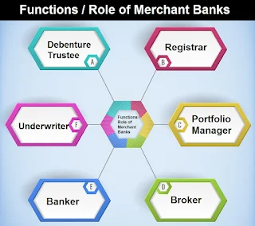

Slide 11


