Slide 1
COMMUNICATION
SKILLS

Slide 2
LISTENING
Listening is an active process by which we make sense of, assess, and respond to what we hear. The listening process involves five stages: receiving, understanding, evaluating, remembering, and responding
The 7 types of listening skills are:
Informational listening
Discriminative learning
Biased listening
Sympathetic listening
Comprehensive listening
Therapeutic listening
Critical listening

Slide 3
Barriers to Listening
Physical and environmental barriers
Cultural barriers
Emotional and psychological barriers
Physiological barriers
Language barriers
Making assumptions
Too much information
Tone of voice
Speed of speech

Slide 4
SPEAKING
Speaking is an interactive process where information is shared, and if necessary, acted upon by the listener. So, it’s important to develop both speaking and listening skills in order to communicate effectively.
There are four elements of speaking skills, namely:
Grammar
Pronunciation
Vocabulary
Fluency

Slide 5
READING
Reading skill is the ability to derive meaning from a written text. This means that a person with this skill can make sense of the written information.
There are four types of reading skills.
Skimming
Scanning
Intensive
Extensive

Slide 6
WRITING
Writing skills are the skills you use to write effectively and succinctly. Writing skills don’t just include the physical act of writing. Skills like research, planning and outlining, editing, revising, spelling and grammar, and organization are critical components of the writing process.
Types of written communication
Formal communication
Informal communication
Academic writing
Creative writing

Slide 7
DIGITAL LITERACY
Digital literacy is an individual's ability to find, evaluate, and communicate information using typing or digital media platforms. It is a combination of both technical and cognitive abilities in using information and communication technologies to create, evaluate, and share information.
Digital literacy skills continue to develop with the rapid advancements of artificial intelligence (AI) technologies in the 21st century. AI technologies are designed to simulate human intelligence through the use of complex systems such as machine learning algorithms, natural language processing, and robotics As the field advances and transforms aspects of everyday life such as education, workplaces, and public services, individuals must develop the skills to appropriately understand and use these tools.

Slide 8
Common elements of these frameworks include:
Know and understand: know the basic functions of AI and how to use AI applications
Use and apply: applying AI knowledge, concepts and applications in different scenarios
Evaluate and create: higher-order thinking skills (e.g., evaluate, appraise, predict, design)
Ethical issues: considering fairness, accountability, transparency, and safety with AI
Digital literacy is necessary for the correct use of various digital platforms. Digital literacy can also prevent people from being taken advantage of online, as photo manipulation, E-mail frauds and phishing often can fool the digitally illiterate, costing victims money and making them vulnerable to identity theft.^{[30]} However, those using technology and the internet to commit these manipulations and fraudulent acts possess the digital literacy abilities to fool victims by understanding the technical trends and consistencies; it becomes important to be digitally literate to always think one step ahead when utilizing the digital world.

Slide 9
Websites like Facebook and Twitter, (now X), as well as personal websites and blogs, have enabled a new type of journalism that is subjective, personal, and "represents a global conversation that is connected through its community of readers."[
Applications of digital literacy
Educators have also turned to social media platforms to communicate and share ideas with one another.
In the workforce
In the modern world employees are expected to be digitally literate, having full digital competence. Those who are digitally literate are more likely to be economically secure, as many jobs require a working knowledge of computers and the Internet to perform basic tasks.

Slide 10
USE OF SOCIAL MEDIA
Social media are interactive technologies that facilitate the creation, sharing and aggregation of content, ideas, interests, and other forms of expression through virtual communities and networks.^{[1][2]} Social media refers to new forms of media that involve interactive participation.
there are some common features:
Social media are interactive Web 2.0 Internet-based applications.
User-generated content—such as text posts or comments, digital photos or videos, and data generated through all online interactions—is the lifeblood of social media
Users create service-specific profiles for the website or app that are designed and maintained by the social media organization.
Social media helps the development of online social networks by connecting a user's profile with those of other individuals or groups.

Slide 11
NON-VERBAL COMMUNICATION
Nonverbal communication, transfer of information from one person to another without the use of words or spoken language. Nonverbal communication can occur in a variety of ways, including through facial expressions, gestures, and body posture or position.

Slide 12
Types of Non-verbal communication
Facial expressions
Gestures
Paralinguistics
Body language
Proxemics
Haptics
Appearance
Artifacts (objects and images)

Slide 13
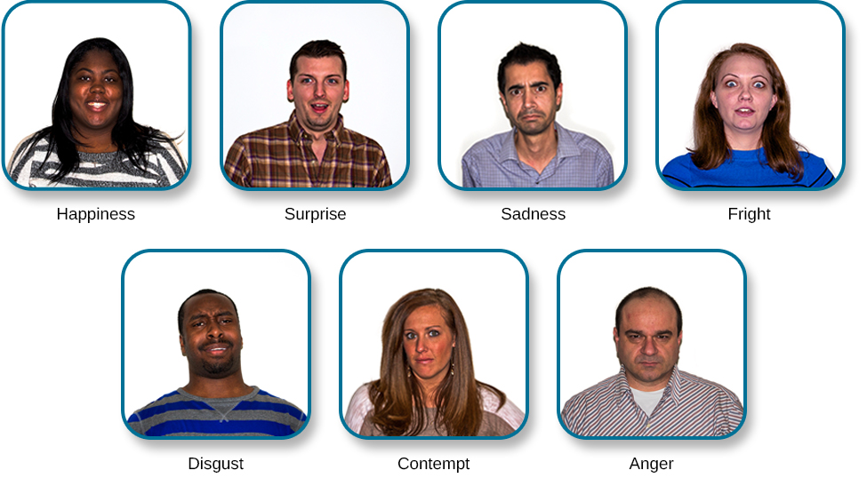
Facial Expressions

Slide 14
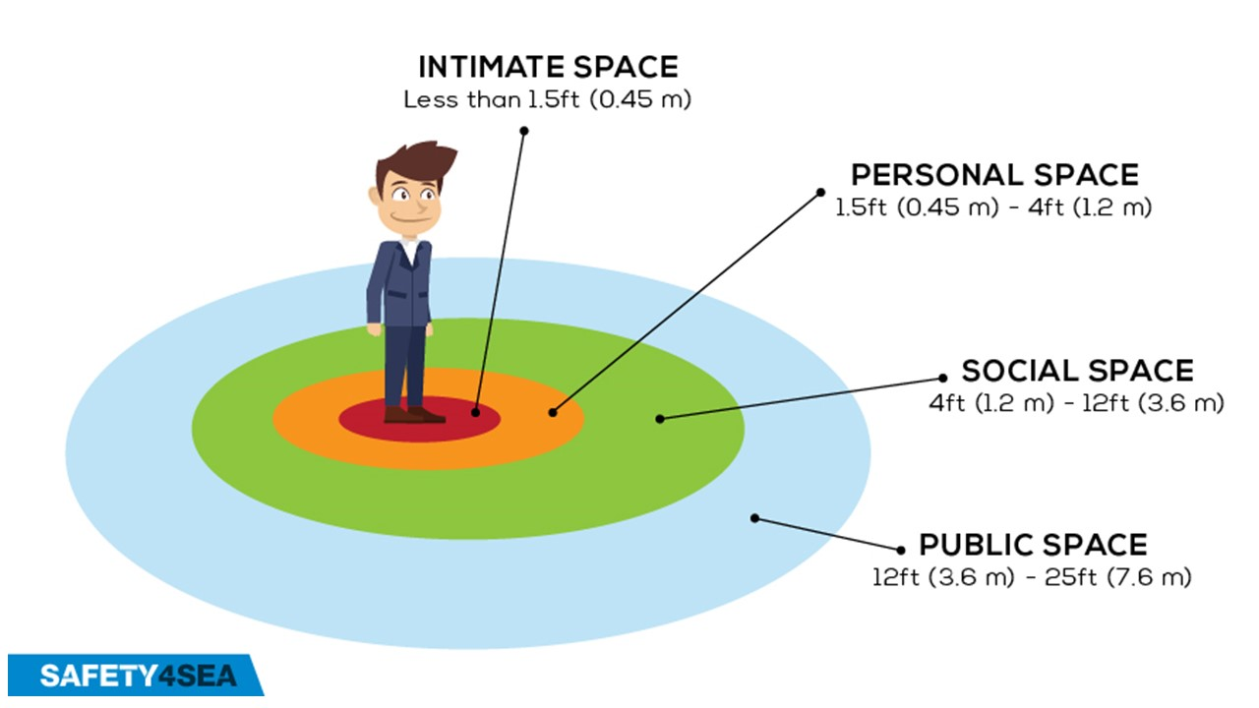
Proxemics

Slide 15
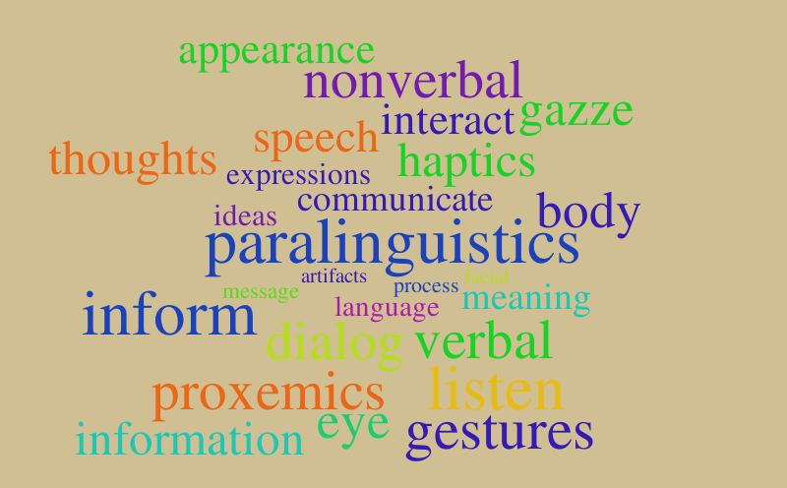

Slide 16
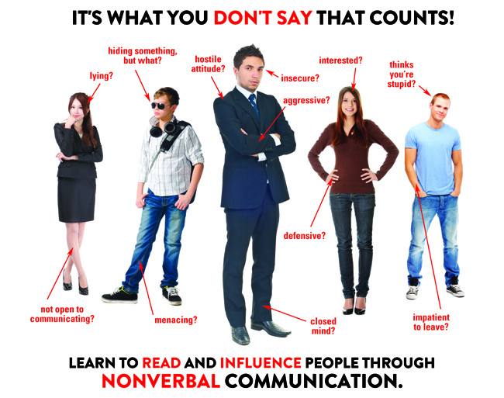
Body Language

Slide 17
PREPARED BY:
MOHAMMED ANAS UZ ZAMAN
B. Com (GENERAL)
2nd Year

