Slide 1
VOUCHERS
BY KALA BAI
FACULTY OF COMMERCE

Slide 2
VOUCHERS
A voucher is written document in support of a transactions .
The company transactions are recorded on the basis of some documentary proof.
The source of download is popularly known as vouchers.
Vouchers are sales invoices, pay register , invoice, receipts, cash memos, travelling bills etc.

Slide 3
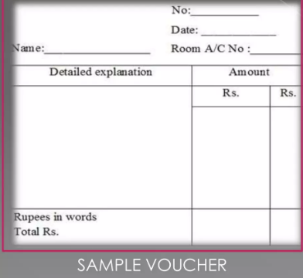

Slide 4
Types of vouchers
Vouchers
Supporting vouchers
Accounting vouchers

Slide 5
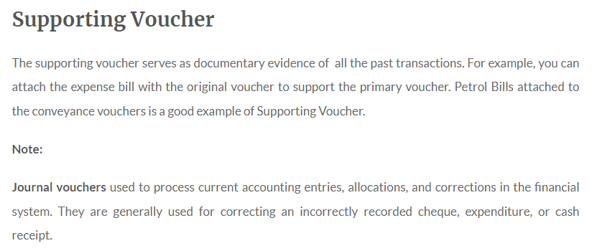
Supporting vouchers

Slide 6
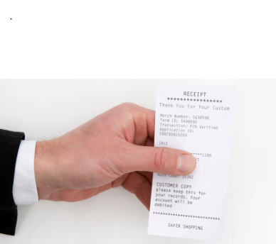
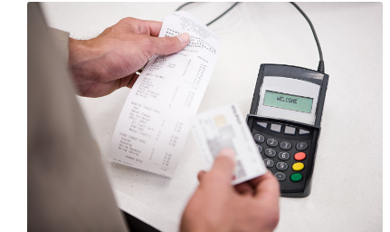

Samples of supporting vouchers

Slide 7
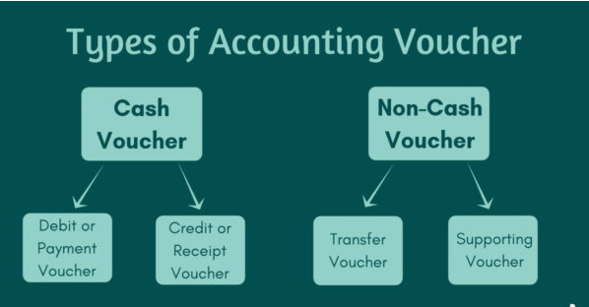

Slide 8
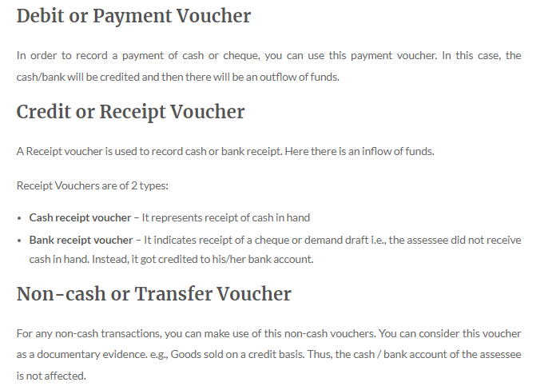

Slide 9
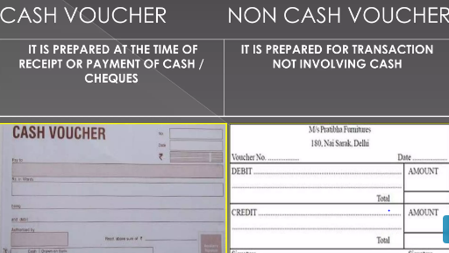

Slide 10
Types of vouchers in tally ERP .9
There are 8 types of vouchers in tally erp.
Receipts voucher
Contra voucher
Payment voucher
Purchase voucher
Sales vouchers
Journal vouchers
Debit note
Credit note

Slide 11
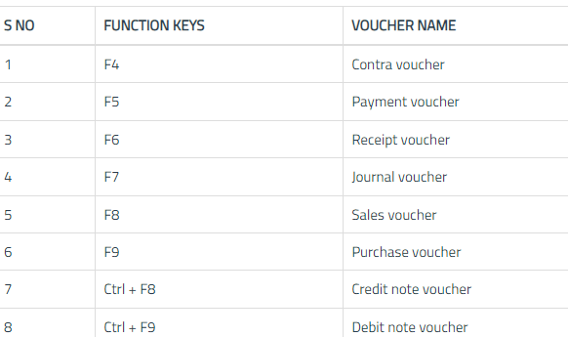

Slide 12
CONTRA VOUCHER
Contra entry is used to transfer amount from cash a/c to bank a/c & vise versa. it helps user to make an entry
It involves following
Cash to cash a/c
Cash to bank a/c
Bank to cash a/c
Bank to bank a/c

Slide 13
Contra voucher
The Contra Voucher can be recorded using Single entry mode or Double Entry mode . To toggle between Single Entry and Double Entry mode, we need to change the setting Use Single Entry mode for Paymt/Rcpt/Contra to Yes/No in F12: Configure .
Refer to F12: Configuration in Tally.ERP 9 for more details.
To view Contra Voucher creation screen in Single Entry mode,
1. Go to Gateway of Tally > Accounting Vouchers > Select F4: Contra
2. For example, to transfer funds from Cash Account to Bank Account:
● Debit the Bank Account.
● Credit the Cash Account.

Slide 14
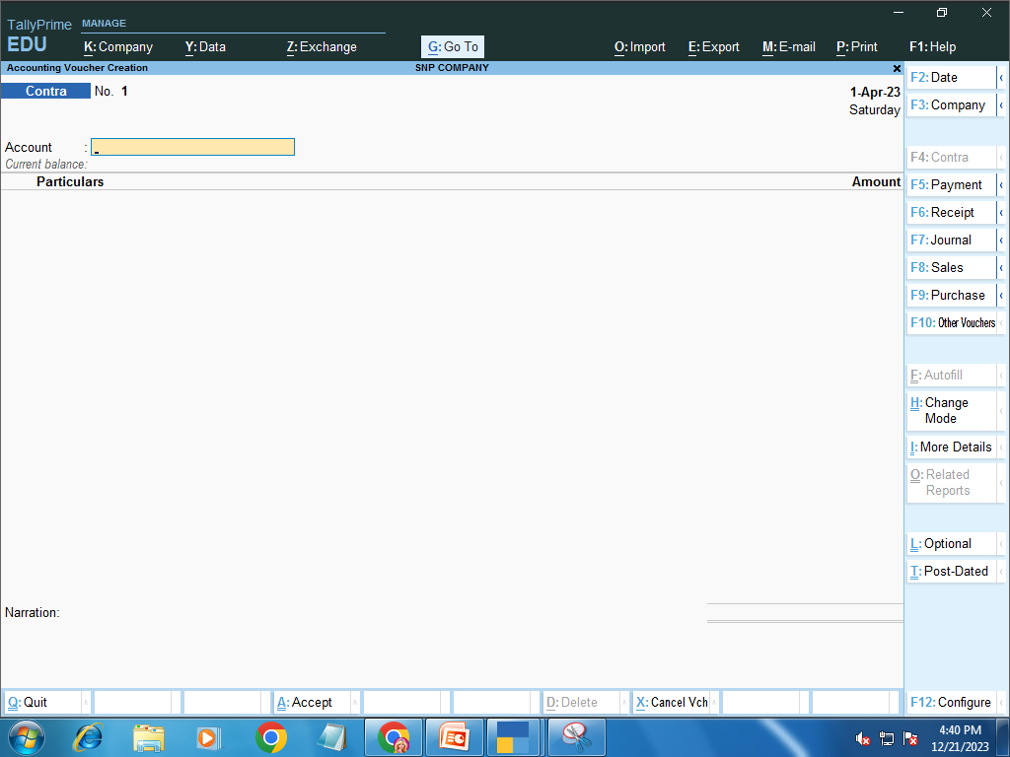
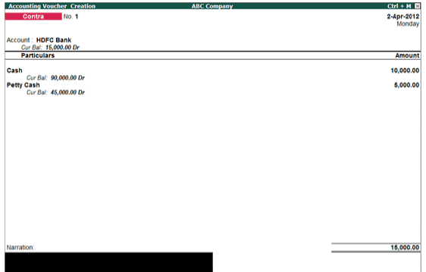

Slide 15
Payment voucher
Payment voucher is used to account all the payments made by the company by way of Cash/Bank.
Payment voucher can be passed using Single Entry or Double Entry mode by configuring the setting Use Single Entry mode for Pymt/Rcpt/Contra in F12 configuration .

Slide 16
Payment voucher
All the transactions related to payment by cash or bank are recorded in payment vouchers
Payments can be towards purchases, expenses, acquisition of fixed assets etc.
Payment voucher can be passed using Single Entry or Double Entry mode by configuring the setting Use Single Entry mode for Pymt/Rcpt/Contra in F12 configuration

Slide 17
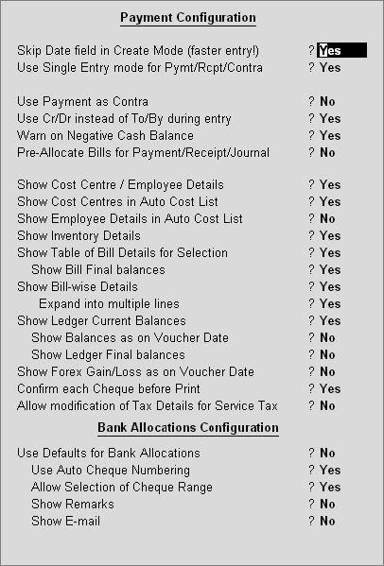
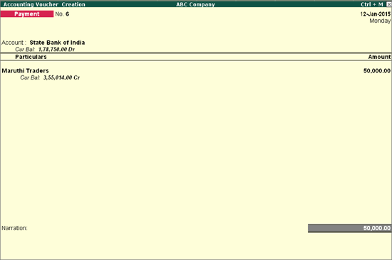

Slide 18
RECEIPT VOUCHER
In Tally ERP 9, a receipt voucher is a type of accounting voucher used to record money received from customers. Receipt vouchers are used to keep track of all income received by a business, such as payments received for goods or services sold.
● Go to Gateway of Tally > Accounting Vouchers.
● Select F6: Receipt from the button bar or press F6.

Slide 19
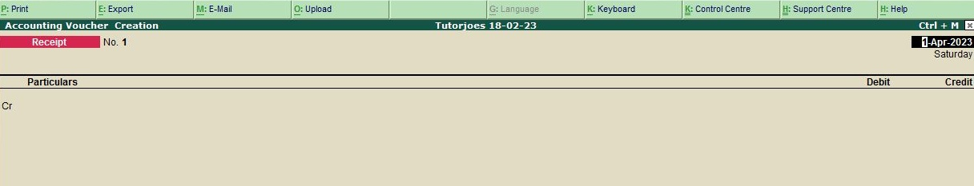

Slide 20
Purchase voucher
When a company buys goods on credit or cash, Purchase voucher is used to record all the Purchase transactions of the company.
Go to Gateway of Tally > Accounting Vouchers.
Click on F9:Purchase on the Button Bar or press F9 .
In tally purchase can be recorded in two modes
As voucher: it is done in case of manual accounting by entering debit and credit accounts .
As invoice :you can enter transaction in the style of invoice mode

Slide 21
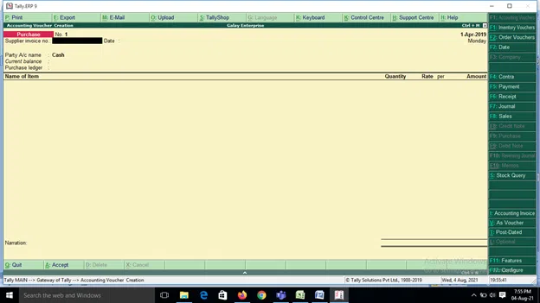
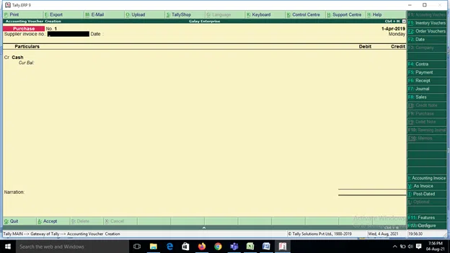

Slide 22
Sales voucher
Whenever you sell a product or service, you record sales entries. In tally, the sales are recorded through the sales voucher. It is one of the most widely used accounting vouchers in tally. There are two modes for accounting in sales vouchers- Invoice mode and Voucher mode. You can use either of them. You can print the copy of your invoice to the party in Invoice mode. In Voucher mode, you can record the transaction for statutory purposes where you don’t need to print the invoice document.
Go to Gateway of Tally > Accounting Vouchers.
Click on F8: sales on the Button Bar or press F8 .

Slide 23
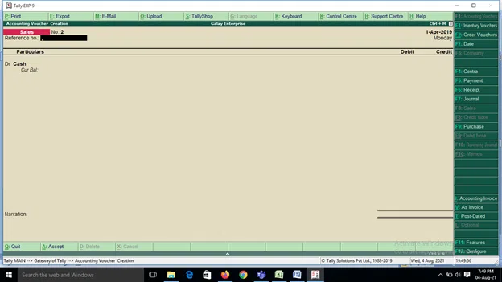

Slide 24
Journal voucher
This voucher can be used for multiple reasons. Some use it for sales, purchases, depreciation; any adjustment entry can also be done using this voucher in Tally. This voucher is available in both accounting and inventory vouchers in Tally. In inventory mode, the entry relating to the movement of goods can be passed.
Go to Gateway of Tally > Accounting Vouchers.
Click on F7: journal voucher on the Button Bar or press F7.

Slide 25
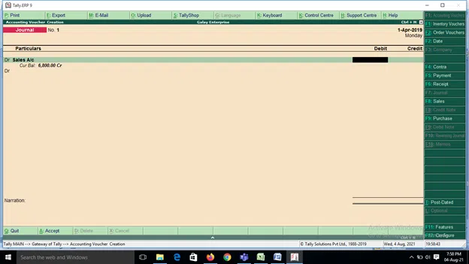

Slide 26
Credit note
Credit Note entry is passed when there is a sales return transaction. This voucher usually remains deactivated by default. You can activate it by pressing F11 and configuring features in invoicing. You can refer to the original sales invoice against which this entry is passed to keep track of such transactions. When a party is selected, you will come across the list of invoices against which this credit note voucher is used. Credit notes can also be used either in invoice mode or as voucher mode as could be used in Sales Voucher.
To Activate the Credit Note and Debit Note feature, you can select F11 and activate the credit and debit note feature as under:

Slide 27
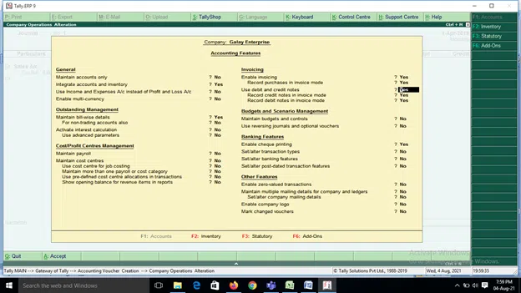
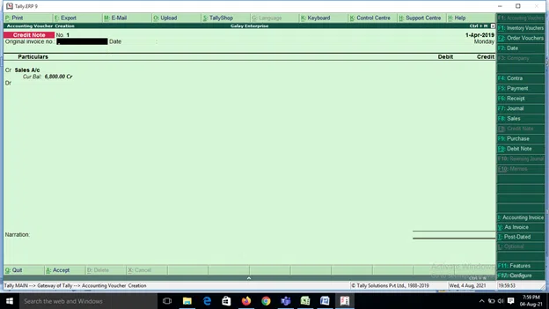

Slide 28
Debit note
Debit Note entry is passed when there is a purchase return transaction. This voucher is deactivated by default. You can activate it by pressing F11 and configuring its features. You can refer to the original purchase invoice against which this entry is passed for maintaining track of such transactions. When a party is selected, you will come across the list of invoices against which this Debit note voucher is used. Debit notes can also be used either in invoice mode or voucher mode as utilised in Purchase Voucher.

Slide 29


