Slide 1
DIAGRAMMATIC AND GRAPHIC REPRESENTATION

Slide 2
Presentation Diagrams and Graphs
Diagrams and graphs are easy methods of understanding of data as they are a visual form of presentation of presentation of statistical data.
Diagrams and attractive and useful to find out the result. Data should be simplified before presenting in the diagram. Two or more sets of data can be compared with the help of diagrams. Diagrams provide moiré information than the table.

Slide 3
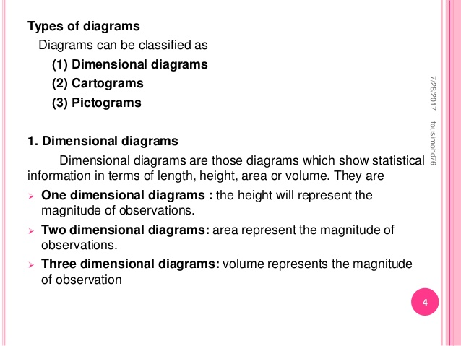

Slide 4
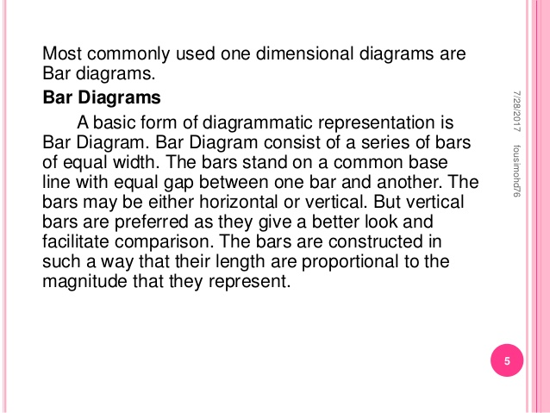

Slide 5
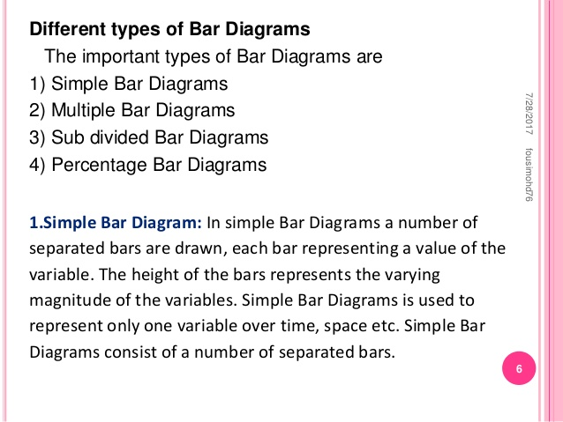

Slide 6
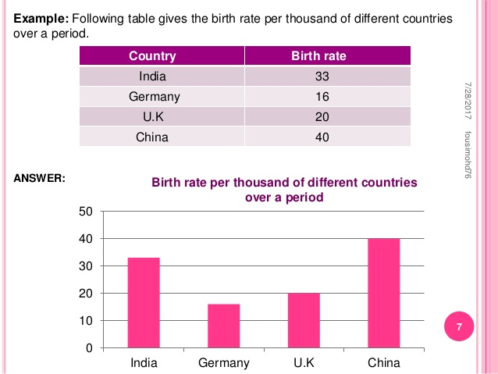

Slide 7
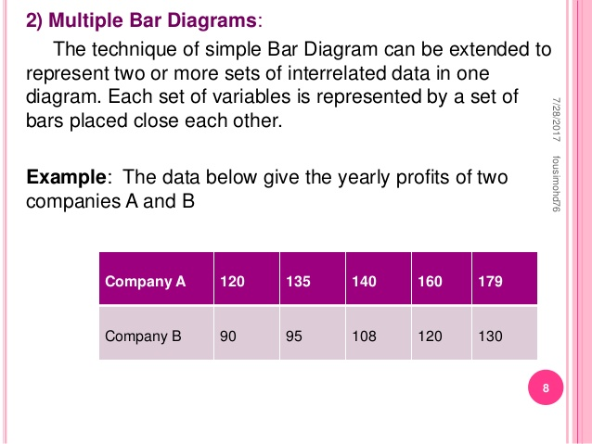

Slide 8
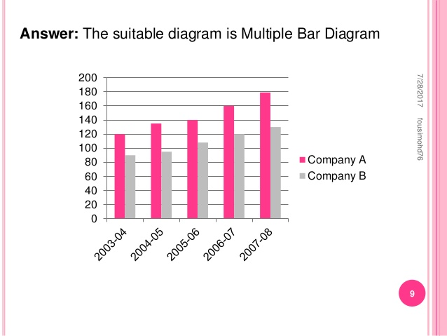

Slide 9
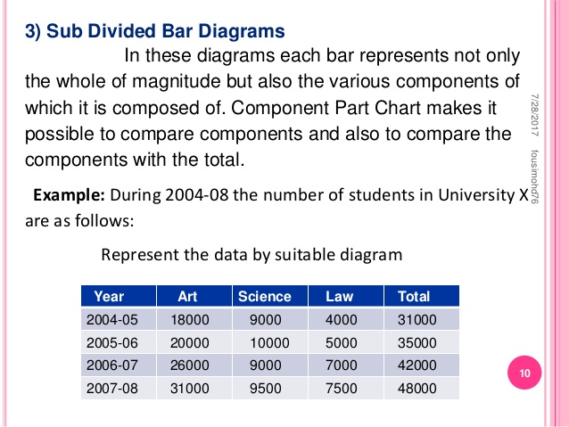

Slide 10
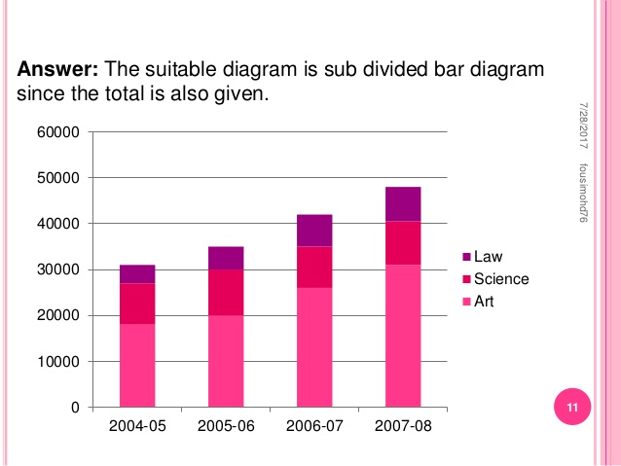

Slide 11
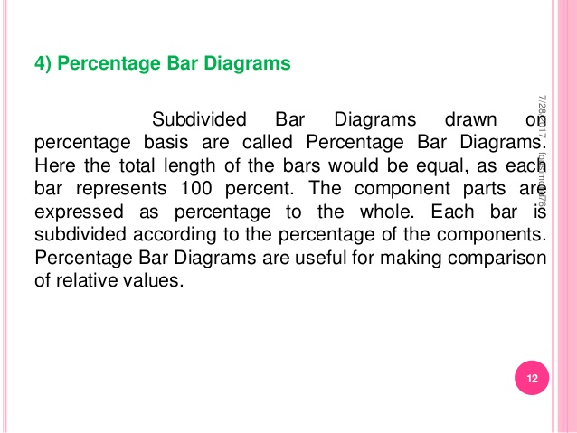

Slide 12
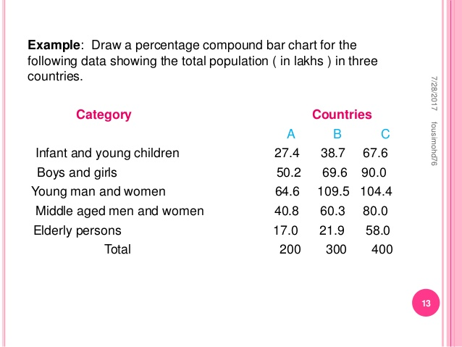

Slide 13
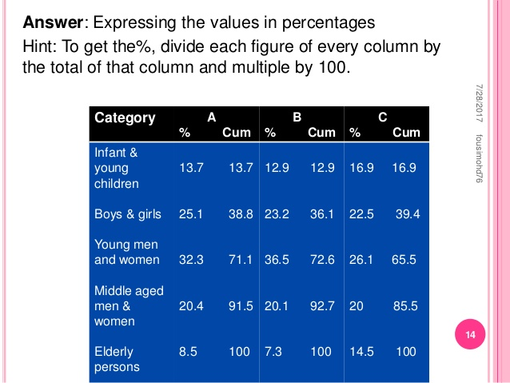

Slide 14
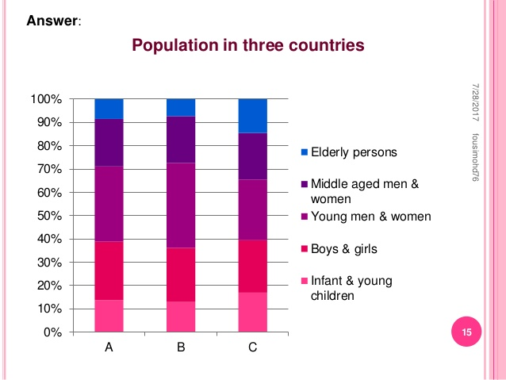

Slide 15
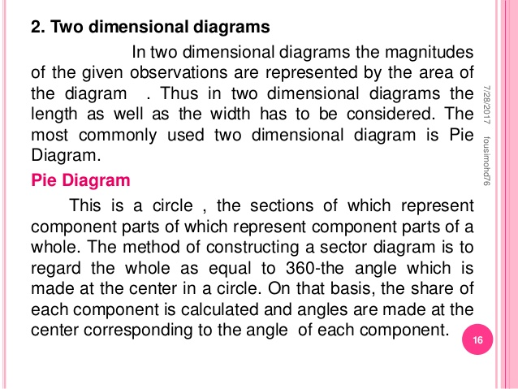
Two dimensional diagram

Slide 16
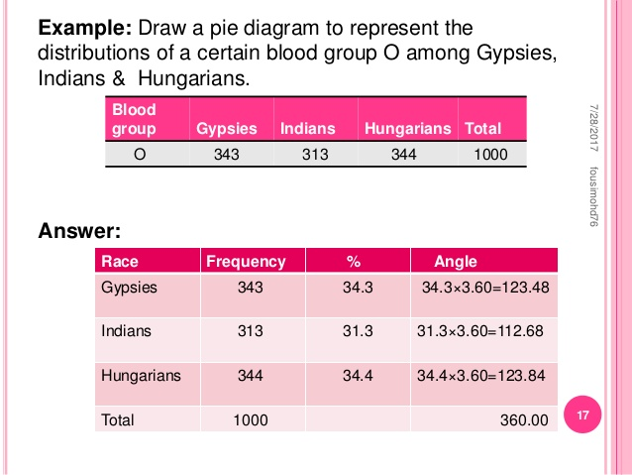

Slide 17
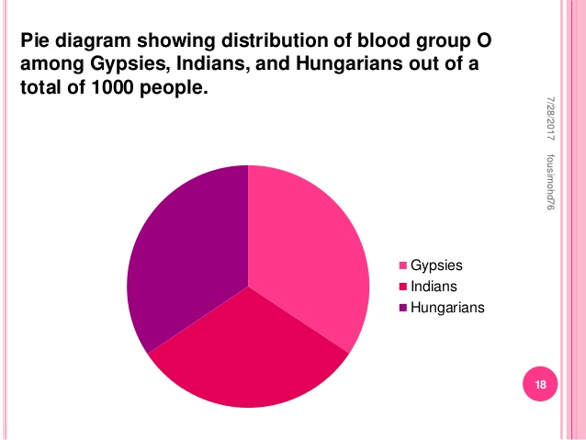

Slide 18
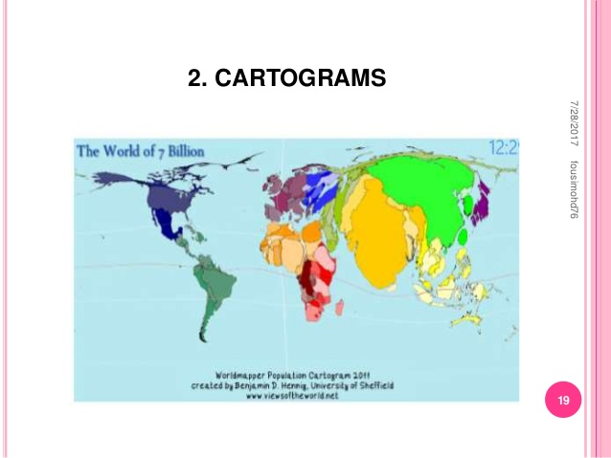

Slide 19
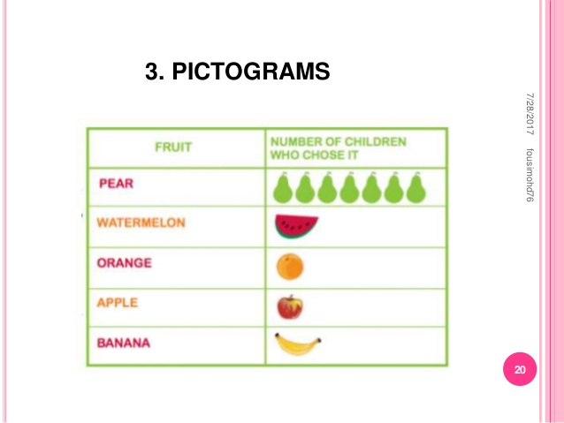

Slide 20
