Slide 1

Debt markets are financial markets where investors lend money to borrowers who seek funds.
KB

Slide 2
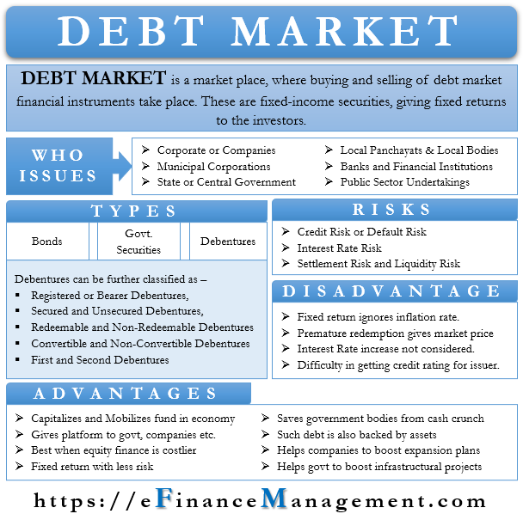

Slide 3



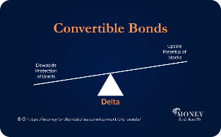
Understanding Debt Market: Types of Debt Instruments
Corporate Bonds
Treasury Bills
Mortgage-Backed Securities
Convertible Bonds
Issued by companies to raise funds for business operations or capital expenditure.
Short term government securities that mature in one year or less and are issued to control money supply.
Allows bondholders to exchange their bonds for a specified number of shares in the company.
Created by grouping various mortgages together to sell as a single security.

Slide 4
The Participants in Debt Markets
Issuers
Investors
Who need funds to meet their financial obligations.
Who purchase debt securities to earn returns.
Traders
Regulatory Bodies
Buy and sell debt securities on behalf of investors or the firm they work for.
Ensure compliance of issuers and investors with laws and regulations.

Slide 5

Bonds
Bonds are fixed-income securities that are issued by corporations and governments to raise capital. The bond issuer borrows capital from the bondholder and makes fixed payments to them at a fixed (or variable) interest rate for a specified period.
Yield/Yield to Maturity (YTM) – The annual rate of return of a bond that is held to maturity (assuming all payments are not delayed).
Principal (or Face Value) – The initial amount of money invested in the bond.
Maturity – The date that the bond expires, when the principal must be paid to the bondholder.
Coupon Rate – The interest payments that the issuer makes to the bondholder. They are typically made semi-annually (every six months) but can vary.

Slide 6
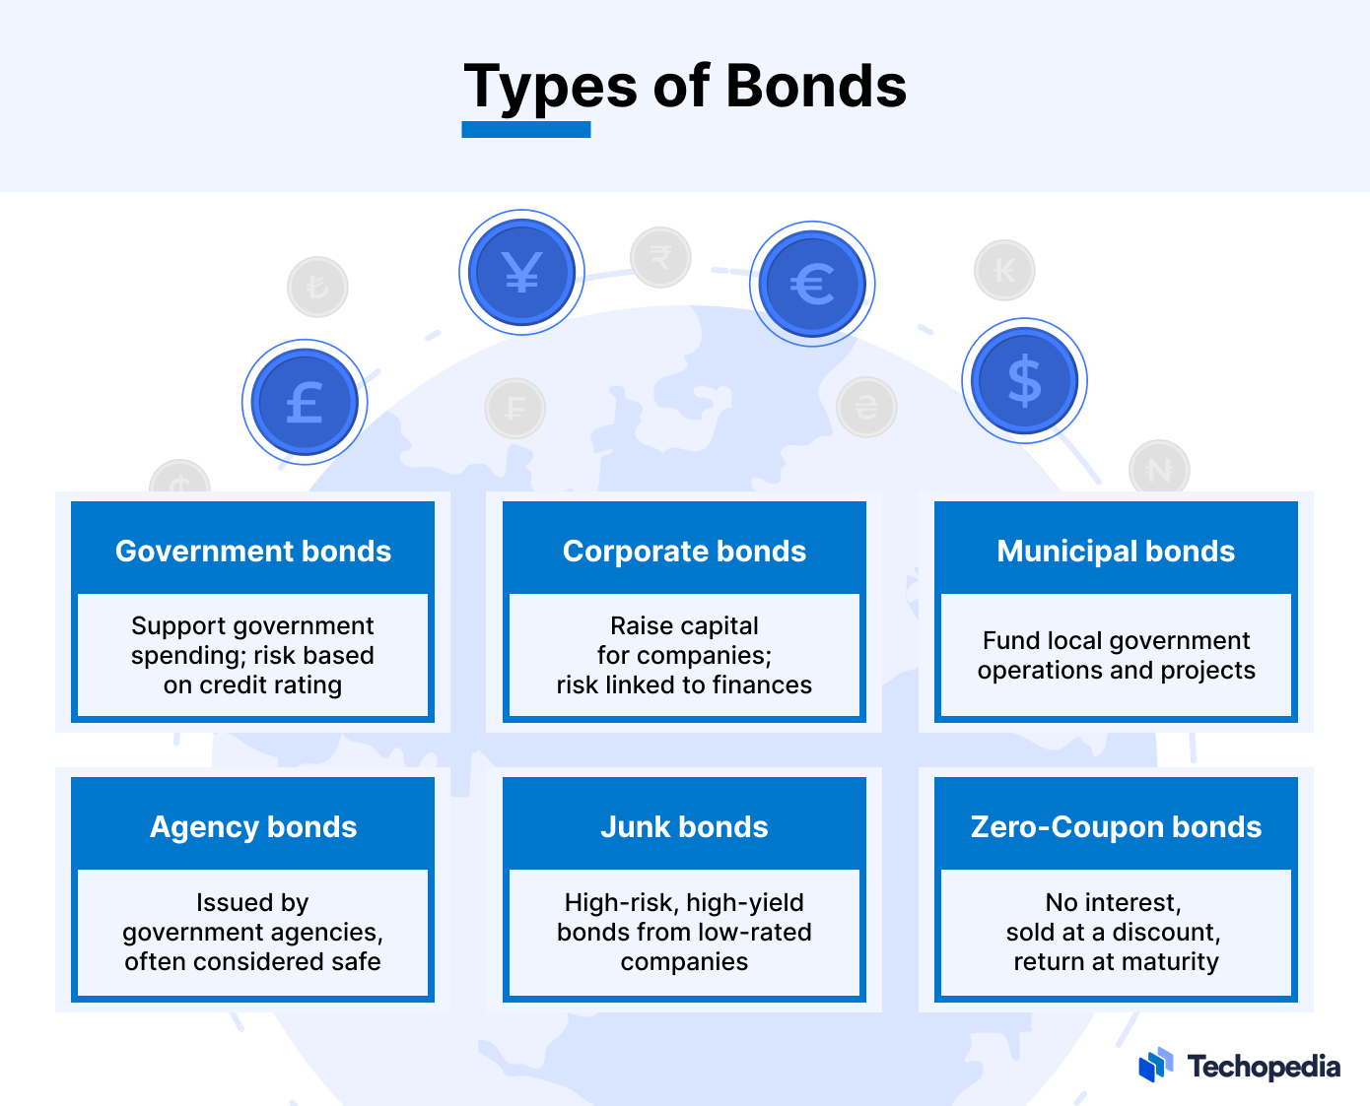

Slide 7

A bond rating is a letter-based credit scoring scheme used to judge the quality and creditworthiness of a bond.
Investment grade bonds are assigned “AAA” to “BBB-" ratings from Standard & Poor's and Fitch, and "Aaa" to "Baa3" ratings from Moody’s. Junk bonds have lower ratings.
The higher a bond's rating, the lower the interest rate it will carry, due to the lower risk, all else equal.
The bond rating agencies rate all types of bonds, from corporate bonds to sovereign bonds.

Slide 8

How Does the Debt Market Function?
1
Issuance
Issuers offer securities to investors at an agreed interest rate.
2
Trading
Investors trade securities in the secondary market to earn interest and capital gains.
3
Redemption
At maturity, the issuer pays the amount borrowed along with the interest.

Slide 9

The Advantages and Disadvantages of Debt Market
1
Advantages
2
Disadvantages
Low cost of borrowing, high liquidity, and flexibility to structure securities to meet investor demand.
Risk of default, loss of value due to fluctuating interest rates, and limited participation for small investors.

