Slide 1
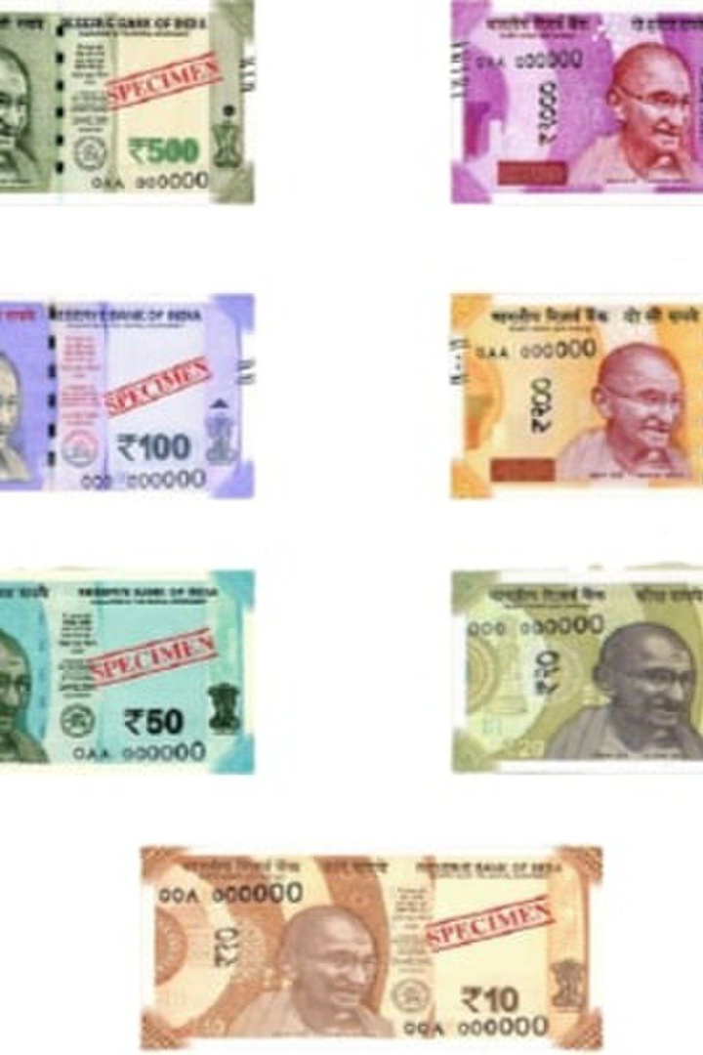
Indian Financial System
An exploration of the robust Indian financial system, its components, regulation, challenges, and future prospects in driving economic growth.

Slide 2

Introduction
Importance of a strong financial system in driving economic growth and stability.
The crucial role played by financial institutions in supporting India's economy.

Slide 3
Components of Indian Financial System
Banking Sector
Capital Market
The backbone of the financial system - facilitating deposits, loans, and various banking services.
A platform for raising capital, comprising of stock exchanges and avenues for equity and debt market transactions.
Insurance Sector
Non-Banking Financial Companies
Safeguarding people and businesses against various risks through insurance products and services.
Complementary financial entities providing credit, investment, and other financial activities.

Slide 4

Regulation and Supervision
1
Regulatory Framework
2
Role of RBI and SEBI
Stringent rules and regulations governing financial institutions to maintain stability and protect investors.
The Reserve Bank of India (RBI) and Securities and Exchange Board of India (SEBI) overseeing banking, monetary policy, and stock market regulations.

Slide 5

Challenges and Issues
1
Financial Inclusion
2
Non-Performing Assets (NPAs)
Ensuring access and affordability of financial services for all sections of society.
Tackling the challenge of bad loans and managing risks within the banking system.
3
Cybersecurity
Addressing the increasing risks posed by cyber threats to financial institutions and customer data.

Slide 6
Future of Indian Financial System
1
Digital Revolution and Fintech Inclusion
2
India as a Global Financial Hub
The integration of technology, digital payments, and innovative startups driving financial inclusion and efficiency.
Seizing opportunities to become a global player in financial services, attracting investments, and fostering international collaborations.

Slide 7

Components of Financial System
A financial system refers to a system which enables the transfer of money between investors and borrowers. A financial system could be defined at an international, regional or organizational level. The term “system” in “Financial System” indicates a group of complex and closely linked institutions, agents, procedures, markets, transactions, claims and liabilities within an economy. There are five components of Financial System which is discussed below:
1. Financial Institutions: It ensures smooth working of the financial system by making investors and borrowers meet. They mobilize the savings of investors either directly or indirectly via financial markets by making use of different financial instruments as well as in the process using the services of numerous financial services providers. They could be categorized into Regulatory, Intermediaries, Non-intermediaries and Others. They offer services to organizations looking for advises on different problems including restructuring to diversification strategies. They offer complete series of services to the organizations who want to raise funds from the markets and take care of financial assets, for example deposits, securities, loans, etc.

Slide 8
2. Financial Markets: A Financial Market can be defined as the market in which financial assets are created or transferred. As against a real transaction that involves exchange of money for real goods or services, a financial transaction involves creation or transfer of a financial asset. Financial Assets or Financial Instruments represent a claim to the payment of a sum of money sometime in the future and /or periodic payment in the form of interest or dividend. There are four components of financial market are given below:
I. Money Market: The money market is a wholesale debt market for low-risk, highly-liquid, short-term instrument. Funds are available in this market for periods ranging from a single day up to a year. This market is dominated mostly by government, banks and financial institutions.
II. Capital Market: The capital market is designed to finance the long-term investments. The transactions taking place in this market will be for periods over a year.
III. Foreign Exchange Market: The Foreign Exchange mareals with the multicurrency requirements which are met by the exchange of currencies. Depending on the exchange rate that is applicable, the transfer of funds takes place in this market. This is one of the most developed and integrated markets across the globe.
IV. Credit Market- Credit market is a place where banks, Financial Institutions (FIs) and Non Bank Financial Institutions (NBFCs) purvey short, medium and long-term loans to corporate and individuals.

Slide 9
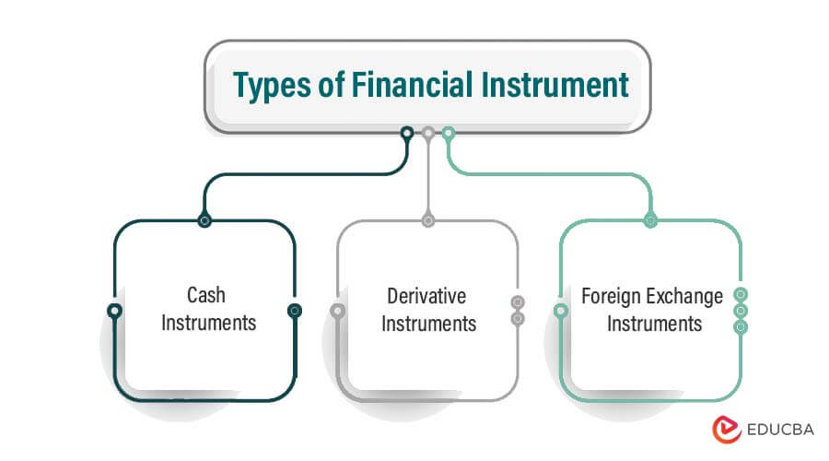
. Financial Instruments: This is an important component of financial system. The products which are traded in a financial market are financial assets, securities or other types of financial instruments. There are a wide range of securities in the markets since the needs of investors and credit seekers are different. They indicate a claim on the settlement of principal down the road or payment of a regular amount by means of interest or dividend. Equity shares, debentures, bonds, etc. are some examples.

Slide 10
Financial Services: It consists of services provided by Asset Management and Liability Management Companies. They help to get the required funds and also make sure that they are efficiently invested. They assist to determine the financing combination and extend their professional services up to the stage of servicing of lenders. They help with borrowing, selling and purchasing securities, lending and investing, making and allowing payments and settlements and taking care of risk exposures in financial markets. These range from the leasing companies, mutual fund houses, merchant bankers, portfolio managers, bill discounting and acceptance houses. The financial services sector offers a number of professional services like credit rating, venture capital financing, mutual funds, merchant banking, depository services, book building, etc. Financial institutions and financial markets help in the working of the financial system by means of financial instruments. To be able to carry out the jobs given, they need several services of financial nature. Therefore, financial services are considered as the 4th major component of the financial system.
5. Money: It is understood to be anything that is accepted for payment of products and services or for the repayment of debt. It is a medium of exchange and acts as a store of value. It eases the exchange of different goods and services for money.

Slide 11
4. Conclusion: Hence it can be said that a financial provides a platform to the lenders and borrowers to interact with each other for their mutual benefits. The ultimate profits of this interaction come in the form of capital accumulation (which is very crucial for the developing countries like India, who faces the problem of capital crunch) and economic development of the country.

