Slide 1
Unit 2 : Inventory Info Menu

Slide 2
Inventory info menu
The Inventory Info. menu is displayed in the Gateway of Tally , if you set Maintain Accounts only to No in the F11 > F1: Accounting Features screen.
By using F11: Features , you can enable the various settings under inventory features which determine the information to be entered during transaction entries.
The Inventory Info menu, lists the inventory masters like Stock Group, Stock Items, Units of Measure of the company, using which you can create, alter and display the inventory master details.
Note: The Inventory Info menu is displayed in the Gateway of Tally, if you select Type of company as Maintain Accounts with Inventory in the Company Creation screen.

Slide 3
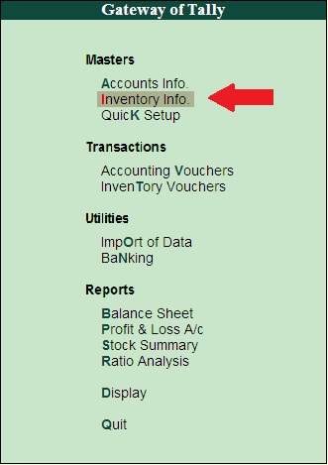
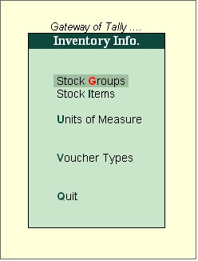

Slide 4
STOCK GROUPS
Stock Groups in Inventory are similar to Groups in Accounting Masters.
They are helpful in the classification of Stock Items.
You can group Stock Items under different Stock Groups to reflect their classification based on some common features such as brand name, product type, quality, and so on.
Grouping enables you to locate Stock Items easily and report their details in statements.
Creation of stock groups
1. Go to
Gateway of Tally > Inventory Info. > StockGroups > Create (under Single Stock Group ).
2. Enter the Name of the Stock Group.
3. Enter additional name apart from primary name [if required] in the field Alias . You can create any number of additional names.
4. Specify whether it is a primary group or a sub-group of another group in the field Under , by selecting from the list.

Slide 5
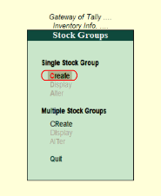

Slide 6
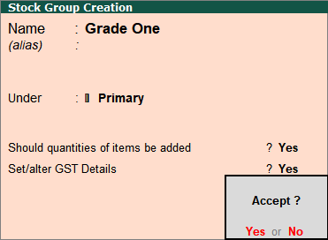

Slide 7
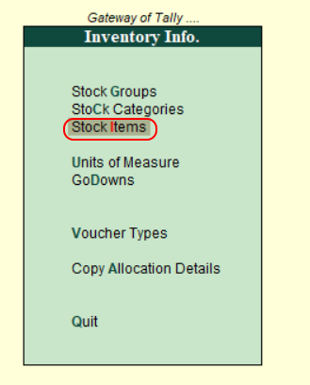
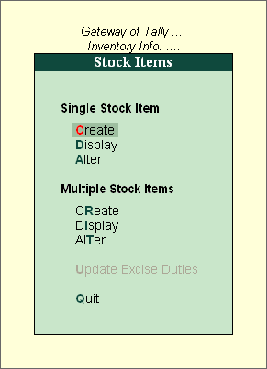

Slide 8
STOCK ITEMS
Stock items are defined as material resources that are held in storerooms and issued to activities that require the materials to be completed.
The stock item record determines whether or not the type of stock can be purchased, repaired, tracked, and so on.
Stock items are goods that you manufacture or trade (sell and purchase). It is the primary inventory entity.
Stock Items in the Inventory transactions are similar to ledgers being used in accounting transactions.

Slide 9
Go to Gateway of Tally > Inventory Info > Stock Item > Single Create (under Single Stock Item)
Specify the Name of the Stock Item.
Specify the Alias name of Stock Item (if required).
The field Under will show the List of Groups. Here you can select the Stock Group to which the Stock Item belongs. By default, Primary Stock Group appears in this field.
This field will show the Unit List. Here you can select the Unit of measurement applicable for the stock item. By default, Not Applicable appears in this field.
Specify the details of Opening Balance, if any, for the Stock Item as on the date of Beginning of Books.
o In the Quantity Field, specify the stock item Quantity, say 5 Nos.
o In the Rate field, specify the stock item Rate, say Rs. 8000 per piece.
o In the Value field, Tally.ERP 9 automatically calculates the value by multiplying the Quantity and Rate.
You can also edit the value, Tally.ERP 9 automatically refreshes the Rate field accordingly.

Slide 10
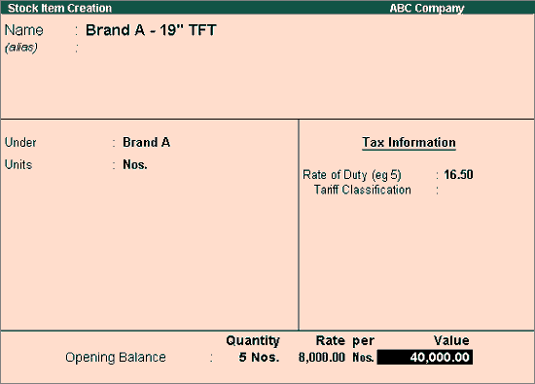

Slide 11
UNITS OF MEASURE
The Units of Measure can either be simple or compound
Examples of simple units are: nos., metres, kilograms, pieces etc.
Steps to create unit of measure
Go to Gateway of Tally > Inventory Info > Units of Measure > Create.
Compound unit is a combination of two simple units.
Examples of compound units are : 1 dozen = 12 numbers , 1 bag = 50 kgs etc
Note : By default Tally. ERP 9 will show the Simple unit for creating the unit of measure.

Slide 12
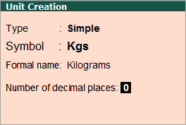
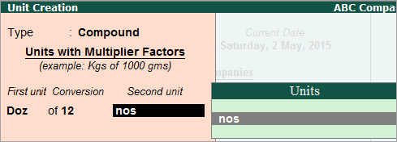
Simple unit of measure
Compound unit of measure

Slide 13
Godown
A godown is a place where stock items are stored. You can specify where the stock items are kept.
You can obtain stock reports for each godown and account for the movement of stock between locations/godowns.
You can create Locations/Godowns in Single mode and Multiple mode.
Steps to create godown
Create Godowns/Locations
Press F11 (Features) > Inventory Features > and set Maintain multiple Godowns as Yes .
Gateway of Tally > Inventory Info. > ...
Name & alias : As in other masters, you can specify multiple aliases for the godown name.
Under : Select Primary or Main Location. ...
Accept the screen.

Slide 14
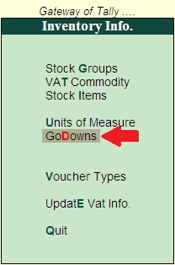
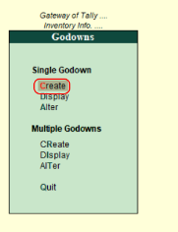

Slide 15
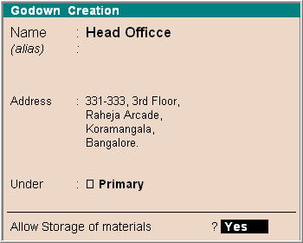
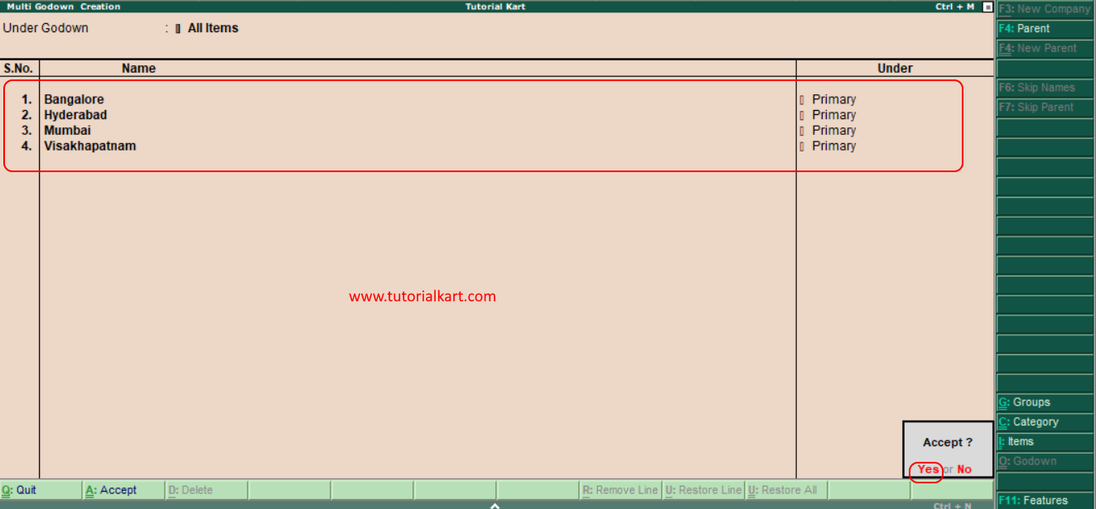
Single godown
Multiple godown

